Slide 1
Blackjack and HI-LO card counting.
A semi-formal illustration of the combinatorial, probabilistic, and statistical principles at play; with simulations.

Slide 2
Learning objectives.
Here are some of the objectives of this presentation:
To show you how HI-LO card counting works.
To show you how HI-LO card counting techniques were developed using techniques, results, and principles in combinatorics, probability theory, and statistics.
To apply, reinforce and in some cases, extend, your existing A-level knowledge in these areas.
As an exercise in applying critical thought and scepticism; and the principled use of your existing knowledge to evaluate claims of a mathematical nature yourself.
To convey a sense of how fundamentally technical insights in applied mathematics can have concrete real-world applications.
To convey how technical insights can allow a better parsing of sources, and provide a degree of critical scrutiny and certainty not otherwise accessible in their absence.
To convey the difference between the pedagogical, sterilised mathematics of A-level and the messy, approximate, but creative use of applied mathematics in real-world applications.
To convey the importance of computers and simulation as distinctive features of 21st Century (techno)-science and applied mathematics.

Slide 3
Why are we undertaking this exercise?
Let’s begin with some preliminary questions to consider, with some pointers to guide discussion.
Why should we care how HI-LO card counting works?
Curiosity/critical scepticism.
Mathematical interest.
History of probability cannot be divorced from the history of gambling – Laplace, Bernoulli,
Generalisable principles to other activities?
Edward Thorp + hedge fund + Kelly criterion.
What real-world implications are there to knowing how HI-LO card counting works?
Player profits.
Player syndicate profits.
21.
Casino portfolio management counter-strategies.
Current state of computer vision algorithms + automated detection systems.
Counter counter-strategies.

Slide 4
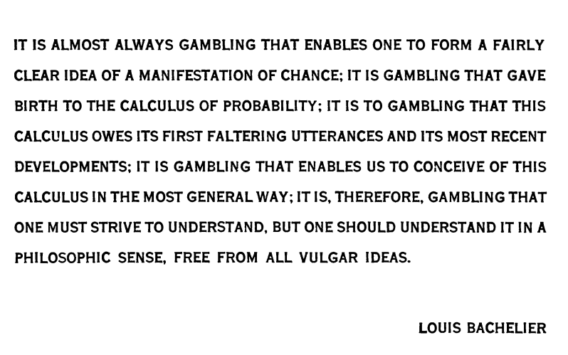
From “How to gamble if you must”, Dubins, L., Savage, L. (1976).

Slide 5
Roadmap.
PART I – Preliminaries.
Expected value.
Laws of Large Numbers.
Basic Strategy.
House Edge.
HI-LO card counting: outline, heuristic arguments, current state of the art. (non-technical).
PART II – Toy model (Red-black).
Indicator functions.
Profit per unit bet.
Conditional expectation, expectation of indicator functions.
Conditonal expected profit per unit bet.
Simple point-count system.
Mean profit per unit bet.
Mean and variance of the conditional expected profit per unit bet.
Developing intuition for these results via numerical plots.
Cumulative distribution of conditional expected profit per unit bet (suppl.)
PART IIa – Narrative survey of the developments leading to HI-LO Card Counting.
PART III- Fundamental Theorem of Card Counting.
PART IV- HI-LO Card Counting.
PART V- Simulation results and statistical analysis.

Slide 6
PART I - Preliminaries

Slide 7
Preliminaries.
The primary focus the presentation is HI-LO card counting (a class of advantage strategy).
However, it is necessary to appreciate what came before HI-LO card counting as reference points to better understand the class of strategy HI-LO card counting is.
To that end we need to look at the following concepts:
Expected value.
Laws of Large Numbers.
Basic Strategy.
House Edge.

Slide 8
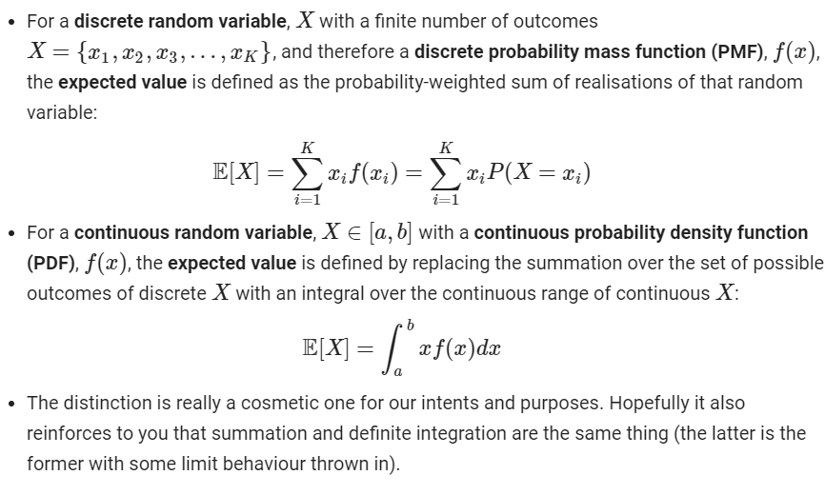
Expected value.

Slide 9
Expected value – simple example.
I use a computer to mimic the artificial construct of flipping a “loaded coin”, that is, a coin that can be appropriately modelled to yield heads with probability 0.3 and to yield tails with probability 0.7.
I offer you a one-time wager. You can opt to bet £100, and if the flipped coin is heads, then I pay you £300. If the coin is tails, then you lose your bet.
At a high-level, what are the arguments for and against playing?

Slide 10
Expected value – simple calculation.
Define a discrete random variable X to be our profit/loss.
In the event of heads, X = 300.
In the event of tails, X = -100.
The discrete random variable X has the following PMF:
P(X = 300) = 0.3
P(X = -100) = 0.7
Compute expected value:
E[X] = (0.3 * 300) + (0.7 * -100) = £20
The expected value is £20, which is positive.
According to this analysis, would you choose to participate in this one-round wager?

Slide 11
Limits on the use of expected value.
So far, we’ve used some theory to justify a decision rule – to choose to place a wager or not.
It’s important to know that every theory has limits. What are those limits?
After participating in the previous one-round wager, we conclude with a profit of either £300, or a loss of £100.
Expected value E[X] indicates a “profit” of £20 per round.
In the case of a one-round wager, do you think the use of expected value arguments are useful?
After the one-round wager, is our actual profit/loss anywhere close to the expected value we have computed?
Is there anything further this argument leaves out that other disciplines might provide comment on?
An economist might note that people have heterogeneous risk preferences (risk averse/risk neutral/risk loving).
A behavioural economist/psychologist might focus on framing effects (prospect theory in the sense of Kahneman and Tversky).
What if we gave you the option to participate in the wager as frequently as one desired? What would be your view then?

Slide 12
Expected value as a statistical average.
The expected value as we have set out is an asymptotic result.
The interpretation is that if we play multiple rounds, record our per-round profit/loss, and take an average to yield a number, that number will converge* to £20 as we play an infinite number of rounds.
Do you know of any statistical results linking sample means and population means? Which is the sample mean, and which is the population mean?

Slide 13
The Laws of Large Numbers (linking sample means and expected value).
Formal justification of the previous interpretation invokes the Laws of Large Numbers (there are two).
These are the Weak Law of Large Numbers and the Strong Law of Large Numbers.
Both of them state that under certain conditions, the sample mean “converges”* to the expected value.
In a sense, they only differ in the subtleties of how this convergence is specified (mathematicians are sticklers for rigour…)
However, the Strong Law is significantly more difficult than the Weak Law to prove.
The Strong Law was only proved in…

Slide 14
Basic Strategy.
First iteration of this strategy developed by Baldwin, Cantey, Maisel, McDermott (1956) in a paper published in the Journal of the American Statistical Association.
Gives a complete specification i.e. a decision rule of what player action to take i.e. {HIT, STAND, DOUBLE, SPLIT} using the following information:
Player’s 2-card hand.
Dealer’s up-card (UK).
Is completely silent on what you should bet.
In many presentations, a fixed unitary bet is assumed.
Key takeaway: Each round of Blackjack is treated independently, and no information about cards from previous rounds is used.

Slide 15
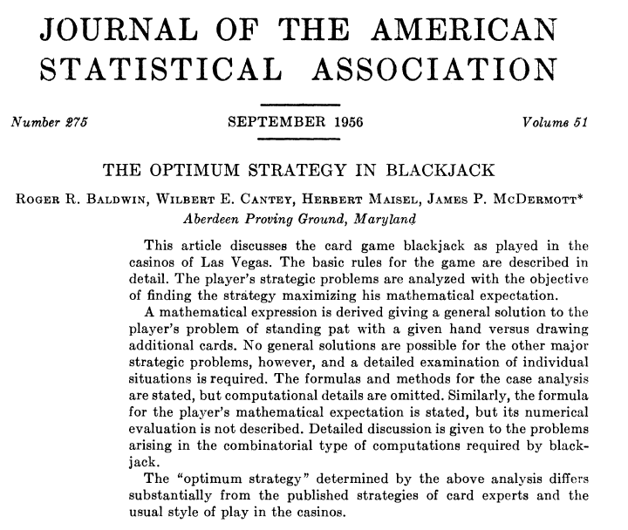
Baldwin, Cantel, Maisel, McDermott (1956)

Slide 16
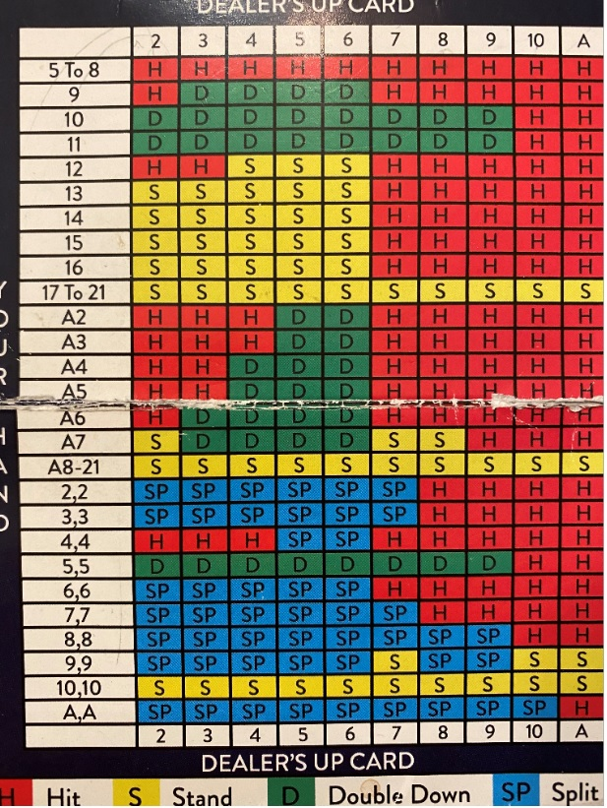
Basic Strategy.
Here is a copy of the Basic Strategy leaflet, from the Hippodrome Casino in Leicester Square, London.
This leaflet will be on the whole the same across all of the casinos in the UK that you might visit.
There may be incredibly minor variations, but on the whole any variations will be highly insignificant.

Slide 17
Basic Strategy.
How is this decision table computed?
We will not reproduce the calculation together (laborious, time-consuming). But necessary for serious understanding.
The key principles underlying the calculation are:
Standard probability laws
Computation of expected values.
Decision on whether to {H, S, D, Sp} is the decision with the highest expected value.
Nested recursive algorithm.
For information on the calculations see Michael Shackleford’s website (Wizard of Odds) for an 18 minute presentation of how to do this using Excel.
There is also a formal write-up and specification of the recursive algorithm by Chongwu Ruan; and a similar one in Ethier.

Slide 18
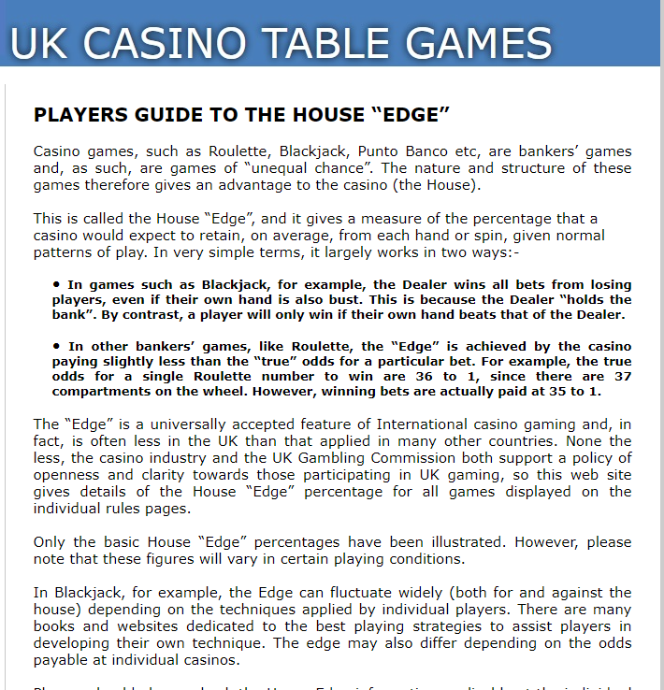
House Edge.
Focus on:
“expect to retain, on average, from each hand or spin, given normal patterns of play.”
“these figures will vary in certain playing conditions.”
“the Edge can fluctuate widely (both for and against the house) depending on the techniques applied by individual players.”
“The Edge may also differ depending on the odds payable at individual casinos.”
Are you satisfied with this definition of the House Edge?

Slide 19
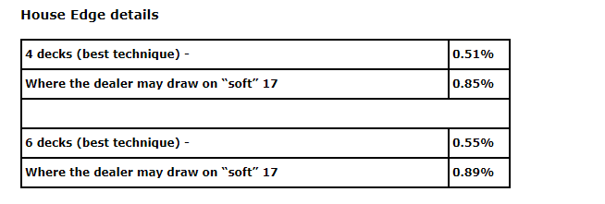
House Edge.
Some questions to think about before we proceed:-
What does “best technique” refer to?
How are these House Edge numbers computed?
What is your interpretation of the numbers, if any?

Slide 20
House Edge.
Last two extracts taken from:
This is the only “official source” of information on the House Edge.
Varies from casino to casino depending on their often hidden assumptions.
“Best technique” refers to a player playing “Basic Strategy”.
It turns out the House Edge numbers are expected values i.e statistical averages.
These can be computed in a similar manner to the way the Basic Strategy is computed (i.e. recursive algorithm for expected value computations), rather than being computed via a combination of simulation and sampling.
Interpretation: Expected value. Starting with £100, you will end up with £99.49 in the long-run (i.e. after an infinite number of one-hand rounds playing a Basic Strategy).

Slide 21
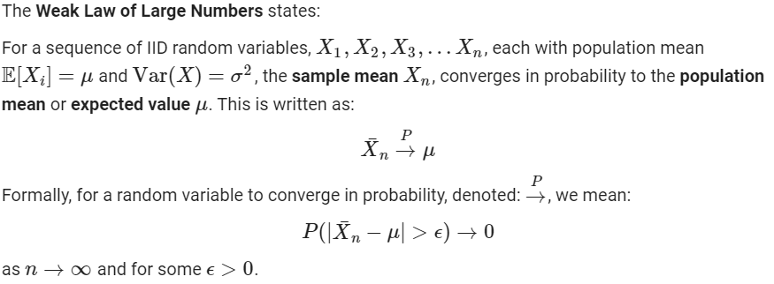
House Edge.
How do we justify the previous interpretation?

Slide 22
HI-LO card counting.
From Wikipedia:
Card counters are a class of advantage players, who attempt to reverse the inherent casino house edge by keeping a running tally of all high and low valued cards seen by the player.
Card counting allows players to bet more when the count gives an advantage as well as minimize losses during an unfavorable count.
The most common variations of card counting in blackjack are based on statistical evidence that high cards (especially aces and 10s, and to a lesser extent 9s) benefit the player more than the dealer, while the low cards, (3s, 4s, 6s, and especially 5s, and to a lesser extent 2s and 7s) help the dealer while hurting the player.
Card counting also provides the ability to alter playing decisions based on the composition of remaining cards.

Slide 23
HI-LO card counting – heuristic arguments.
Higher concentration of high cards benefit the player in the following ways:
It increases the player's chances of hitting a natural Blackjack, which typically pays out 150% of the amount bet (also called 3:2 Blackjack); whereas a dealer's blackjack will only cause the player to lose their original bet.
Doubling down on additional hands can increase expected profit. Additionally, the elevated ratio of tens and aces increases the odds that doubling down will be successful, further increasing expected profit. The dealer cannot double.^{[1]}
It provides additional splitting opportunities for the player; while the dealer cannot split.
A high enough concentration of 10's can make the insurance bet profitable, since it increases the probability of a dealer blackjack.
The higher concentration of tens also increases the odds of the dealer busting (exceeding 21). While this also increases the odds of the player busting, the player can elect to not hit (a “hard” 16, for example) when it is disadvantageous to do so. The dealer must always hit their 15’s and 16’s.
On the other hand, low cards benefit the dealer, since according to blackjack rules the dealer must hit stiff hands (12-16 total) and low cards are safer in these common hands. Thus a dealer holding (12-16) will bust every time if the next card drawn is a 10, making this card essential to track when card counting

Slide 24
Quick question: What are your thoughts and feelings on the arguments presented in the previous slides? Are you sufficiently convinced by the arguments proferred to wager your own money playing a HI-LO card counting system in the casino?

Slide 25
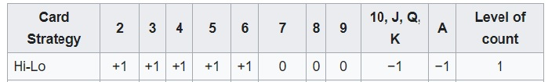
HI-LO card counting system – practical implementation.
Assign point values to all cards dealt in the following way, and keep a running total, known as the running count:
At the start of the next round, convert your running count to a true count by dividing your running count by the number of decks remaining in the shoe*.
If your true count is below 2, then bet the default amount (known as a “fishing bet” in the Blackjack community).
If your true count exceeds 2, then raise your bets by a pre-defined multiple determined before you enter the casino.
Use “Basic Strategy” to inform your play strategy/card-drawing decisions i.e. {H, S, Sp, D}.
* This is estimated by eyeballing the thickness of the stack of cards remaining in the shoe. Card-counting training software exists to assist those looking to practically implement these techniques in casinos on how to improve their ability to estimate the number of decks remaining. Often rounded up or down to an integer value to ease cognitive burden.

Slide 26
Example: It is beginning of the 20th round of Blackjack. Will Lee has been tallying the cards previously and notes that the running count is 4. There is 1 deck remaining in the shoe. Therefore the true count is 4. Dealer asks for Will to place his bets. As the true count is greater than 2, Will, who normally bets the £5 minimum bet as his “fishing bet”, raises his bets by a multiple of 20x to £100. Question: What do you think happens to Will at the end of the evening?

Slide 27
Answer: He’s informed that his custom is no longer welcome at the casino. He is politely asked to leave by casino management, and informed that he is blacklisted from returning.

Slide 28
HI-LO card counting system – variants.
The HI-LO card counting system as we have outlined in the previous slide is probably a prototypical example of a “no-frills” HI-LO strategy.
In the sense that it gives you a simple decision rule on when to raise your bets.
In practice, there is a degree of freedom to choose the following:
True count threshold to raise your bets.
Bet multiple.
Gradation of true counts accompanied with betting multiples.
Further extension: Proportional betting via the Kelly criterion*
Previous outline of a HI-LO strategy would be an example of something you could implement in a casino.
However, you would be asked to leave fairly swiftly, for reasons to be discussed.

Slide 29
HI-LO card counting - any better arguments?
We have previously seen some heuristic arguments concerning how certain HI, LO and neutral cards may benefit the dealer/player.
We have also seen that there is supposedly statistical evidence justifying those heuristic arguments.
Here is an argument that is more closely aligned with the underlying statistical and probabilistic principles:
From Wikipedia:
The goal of a card counting system is to assign point values that roughly correlate to a card's Effect of Removal (EOR). The EOR is the estimated effect of removing a given card from play, and the resulting impact on the house advantage. The player may gauge the effect of removal for all cards dealt, and assess the current house advantage* of a game based on the remaining cards.
*Same concept as House Edge.

Slide 30
Exercise – Critical evaluation.
TO DO: Use google. Do a search for card-counting. Take a sample of the links that explain the principles. Evaluate the arguments presented.
Sample links:
https://www.blackjackapprenticeship.com/how-to-count-cards/
https://www.888casino.com/blog/card-counting-trainer
https://www.mentalfloss.com/article/56506/how-does-counting-cards-blackjack-work
https://wizardofodds.com/games/blackjack/card-counting/introduction/
https://www.casino.co.uk/blackjack/card-counting/
Questions: What is your reaction to the arguments presented? Are they more or less convincing than what we have seen? Where, if anywhere, are they deficient, if so? If deficient, what kind of argument might be more acceptable?

Slide 31
Aims of the previous exercise.
One of the aims of the previous exercise was to convey to you that once you are accustomed to certain ways of thinking, in this case, in the language of statistics and probability, it becomes difficult to accept heuristic arguments without satisfactory justification.
Another aim was to illustrate that certain kinds of technical insight and knowledge cannot be found on media aimed at standard audiences (who may not be trained in interpreting technical insight).
Most technical/scientific insight of a quantitative nature will almost certainly be couched in the language of mathematics, and also statistics.
Often, you need to be selective, critical, and strategic about where you go for certain kinds of information. In our case, the insight we need is contained in academic papers and books.

Slide 32
The deficiencies of common presentations on HI-LO card counting.
The deficiencies I would like to draw your attention to are the following:
Arguments about the benefits to the dealer or player of HI vs LO cards are qualitative arguments.
There was a claim that these arguments were made on the basis of statistical evidence, but where is that statistical evidence?
Most of the websites explain how to implement HI-LO card counting strategies as a decision rule.
None of the justifications go beyond qualitative arguments, no evidence of a quantitative nature is presented, and therefore none give satisfactory justifications for why we should be happy risking our hard-earned money into implementing a strategy like this.
TO DO: Given what you saw with basic strategy, can you formulate a rough criterion that we might work towards to show that HI-LO card counting is indeed profitable?

Slide 33
Solution - the focus of the presentation.
The deficiencies of the previous websites raise some important areas we would like to focus on.
Ideally, we would like to see an analytic derivation showing that implementing HI-LO card counting yields a positive expected value.
We would also like to see:
Statistical evidence to justify the arguments about HI and LO cards.
The probabilistic, statistical and combinatorial principles used to justify the HI-LO card counting system.
Essentially, we are asking for a technical, under-the-hood justification of HOW the HI-LO card-count system works.
Given this unpacking, we can then scrutinise if any unwarranted assumptions are made, any violations or errors of sound principles are committed etc.
Essentially, we are taking on the role of a critical but open-minded sceptic, who benefits from being able to navigate technical insights.

Slide 34
The contemporary state of Blackjack and HI-LO card counting.
It turns out Blackjack is both “simple” and “complicated”. In the sense that since the 1960s, she has largely been considered by the mathematical community to be a “solved game”*.
In the sense that many of her more interesting secrets have largely been revealed; but there is a degree of combinatorial complexity involved.
This combinatorial complexity can only be dealt with approximately i.e. with recourse to simulation, statistics and approximations. More on this later.
Currently, no qualitatively nor quantitatively superior methods exist beyond the justification of HI-LO card counting I have presented here (to the best of my knowledge).
The constraints on our current understanding lie in our ability to efficiently approximate and simulate i.e. are computational constraints.
This combinatorial complexity cannot be dealt with exactly (say in the sense you would ‘solve’ an equation exactly); and it is this residual complexity which means that unless someone completely reworks the wheel on this, Blackjack will not be a completely “solved game” in the sense of not relying on any approximations/simulations/statistical arguments.
Key takeaway:

Slide 35
PART II – Red-black: a toy model.

Slide 36
General rationale for studying a toy model.
Blackjack may be a satisficed game now, but prior to the 1950s no-one had a way* of beating the game which yielded systematic, reliable profits (without recourse to strategems of one kind or another).
The preface to the development of HI-LO card counting was the study of a toy model of Blackjack, known as Red-Black.
The motivation behind studying toy models is to design an appropriate simplification* of a complex phenomenon; in the hope that we can get a handle on the principles at play with the toy model.
Then gradually make more complex by adding layers of realism on, with the hope that it might allow us to better understand the phenomenon of interest.
A way of thinking that is most artfully conducted by engineers and software engineers, less so by economists…
*No one had published a way that was documented in scientific journals, or a way that was widely accepted by the relevant communities as showing conclusive evidence of gains; although that does not rule out that there were people who implemented a systematically profitable strategy for winning – see Ethier (2010).

Slide 37
Specific rationale for studying a toy model.
We study the toy model of Red-Black because it was the setting in which Edward Thorp and William Walden (1973) proved a significant result known as the “fundamental theorem of card counting” (FTCC).
The model of Red-Black appears in Griffin (1999), appears in Ethier (2005).
Historically important object of study that led to the development of results known as “bold play” by a cohort of probabilists and statisticians in the 1950s.
We will not cover the FTCC in its original formulation, as it’s too technical -requires measure theory, which is used for a rigorous formulation of probability theory (usually covered in maths undergrad).
We will arrive at a statement of this result using more elementary tools.
Quantities of interest in the red-black game can be computed exactly.
We can therefore explicitly see where and how we resort to approximations when considering HI-LO card counting in Blackjack.

Slide 38
Red-black: a formal roadmap.
We are interested in computing the following in order to design a simple point count system:
1a. The profit per unit bet.
You can think of this as making use of no statistical information about cards that have come up previously i.e. a player with no memory.
1b. The conditional expected profit per unit bet
You can think of this as making use of all the statistical information about cards that have come up in previous rounds i.e. a player with an eidetic memory.
1c. The mean profit per unit bet.
And in order to scrutinise:
2. The mean and variance of the conditional expected profit per unit bet.
3. The cumulative distribution of the conditional expected profit per unit bet.
a. Compute this approximately using the Central Limit Theorem (i.e. Normal approximation).
b. Compute this exactly.
4. Further observations (optional).
This is optional, but incredibly useful if you want to lay the groundwork/develop intuition for the proof of the FTCC.
This gives us tools to state the fundamental theorem of card counting, and to formalise the workings of an optimal strategy that makes use of statistical info to inform betting.

Slide 39
Toy model formalities – representing a deck of cards.
Discuss this using pen-and-paper – no need for introducing permutations, random permutations, exchangeability, joint distributions at this stage, as not sure what clarity the additional rigour brings at this stage.
Represent (labels of) cards using indexed random variable X.
Assume general comfort with indexing, dummy variables in summation.

Slide 40
Red-black (Ethier 2010).
Consider the following simple game:
We have N cards in a deck, and N is an even number.
For concreteness, let’s say N = 52.
Assume you are allowed to bet, at even money, that the next card dealt is odd (as opposed to even).
Assume that the first n cards have been seen and you bet on the next card (where 0 <= n <= N – 1).
Would you play this game? If so, what strategy would you use?

Slide 41
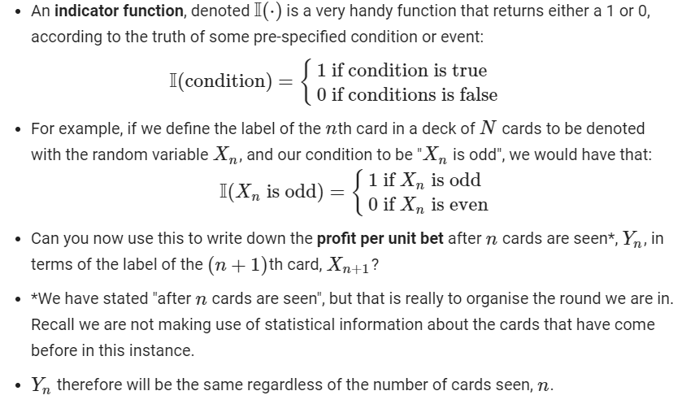
Indicator functions.

Slide 42
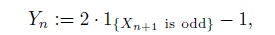
Red-black: Profit per unit bet (1a.)
Assuming that n cards have been seen (0 <= n <= N – 1).
The profit per unit bet is given by:
Are you comfortable with this expression?
Is the profit per unit bet a random variable or a function?
The output of a deterministic function of a random variable is itself a random variable.

Slide 43
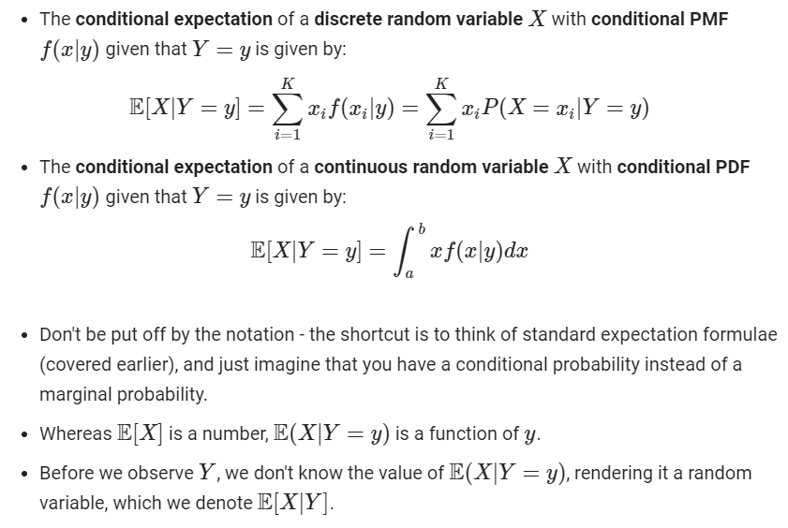
Conditional expectation.

Slide 44
Are you at ease with that definition of conditional expectation? If not, please say and I can go over a simple example with you.

Slide 45
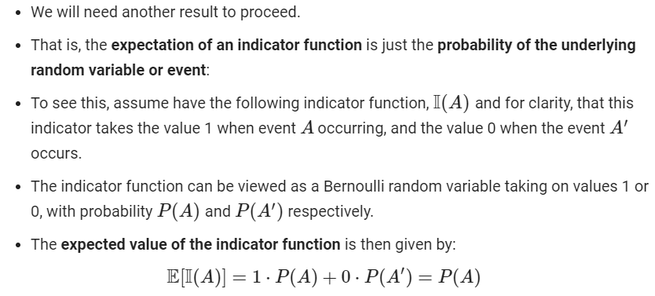
Expectation of an indicator function.

Slide 46
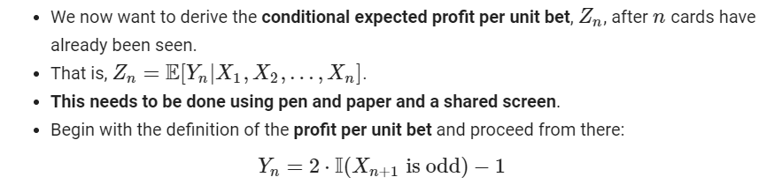
Red-black: Conditional expected profit per unit bet (1b.) – derivation.

Slide 47
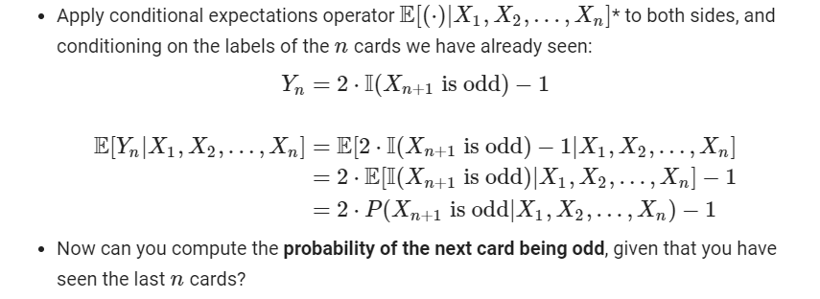
Red-black: Conditional expected profit per unit bet (1b.) – derivation.

Slide 48
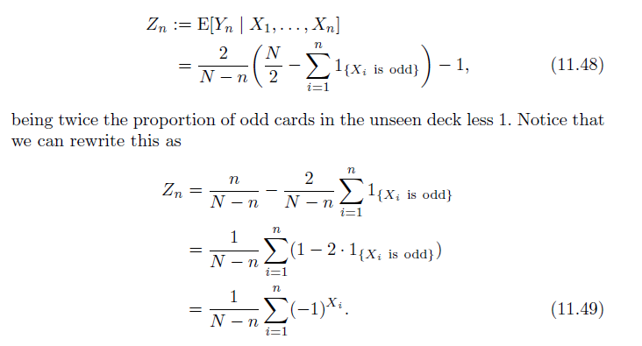
Red-black: Conditional expected profit per unit bet (1b.)

Slide 49
Red-black: A simple point count system.
The last formula indicates how we might go about practically implementing a simple point count system to systematically beat the game.
Player assigns to each odd card the point value -1, and to each even card the point value +1.
The running count is the sum of these point values over all cards seen and is adjusted each time a new card is seen.
The true count is the running count divided by the number of unseen cards.
Eq. (11.49) says that the true count provides the player with his exact conditional expected profit per unit bet on the next card.
This can be used to select a suitable bet size.
Looking ahead: For Blackjack, the situation is more complicated, and the HI-LO true count does NOT equal to the exact conditional expected profit per unit bet.
Looking ahead: In Blackjack, we cannot compute the exact conditional expected profit per unit bet, rather, only an approximation of it under a particular hypothesis. The HI-LO true count is correlated with this approximation.

Slide 50
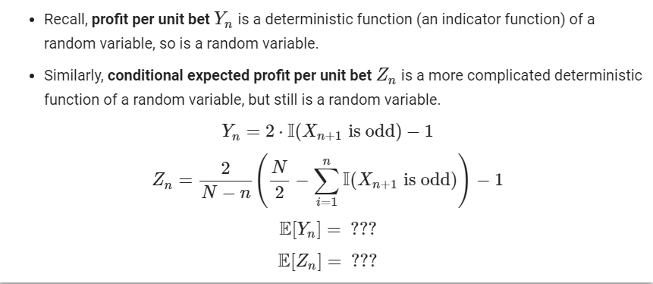
Exercise: Derive the mean profit per unit bet, and the mean conditional expected profit per unit bet.

Slide 51
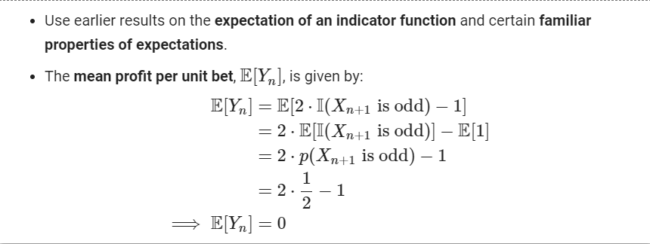
Red-black: Mean profit per unit bet (1c.)

Slide 52
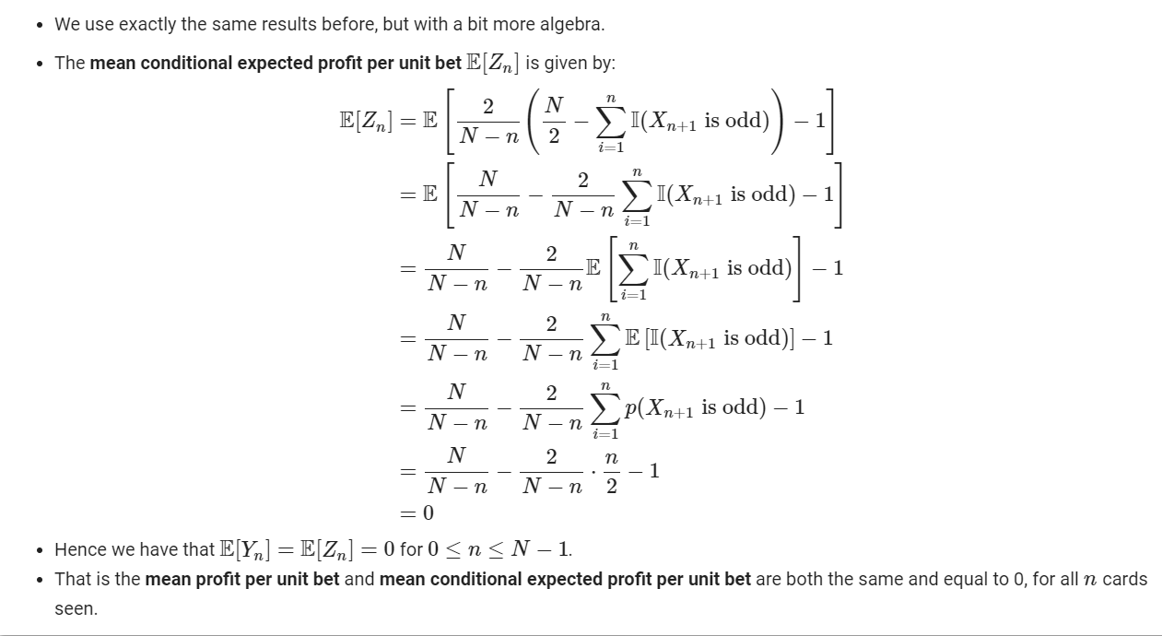
Red-black: Mean conditional expected profit per unit bet (2.)

Slide 53
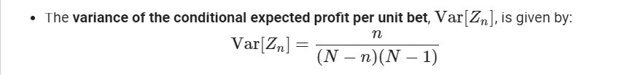
Red-black: Variance of the conditional expected profit per unit bet (2.)
This derivation is a bit more involved (even for a simple example like this), and will take at least a few slides of algebra.
It’s your choice whether you want to work through the derivation together (it’s like a STEP question).
Let’s first state this result, and then evaluate both results.

Slide 54
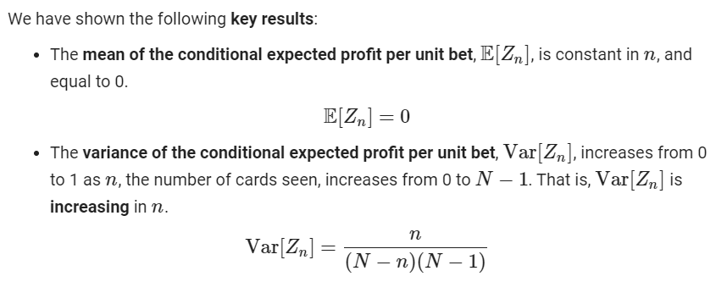
Red-black: Key results.

Slide 55
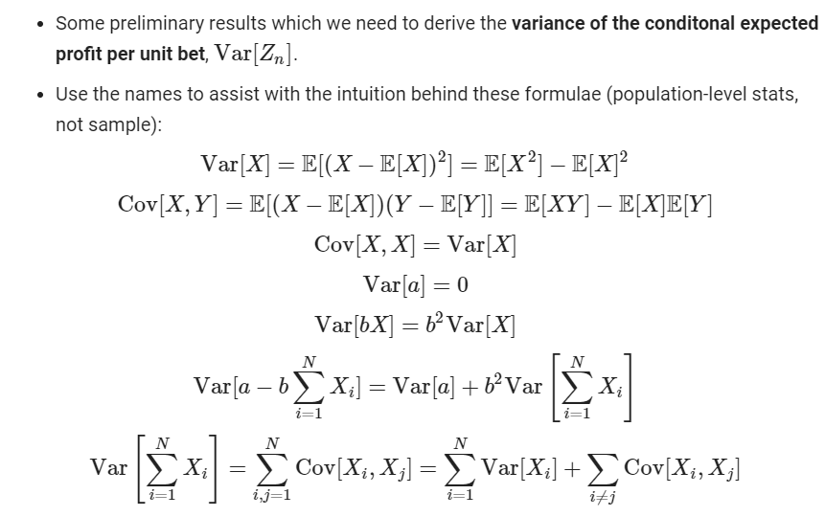
Population variance, covariance and properties.

Slide 56
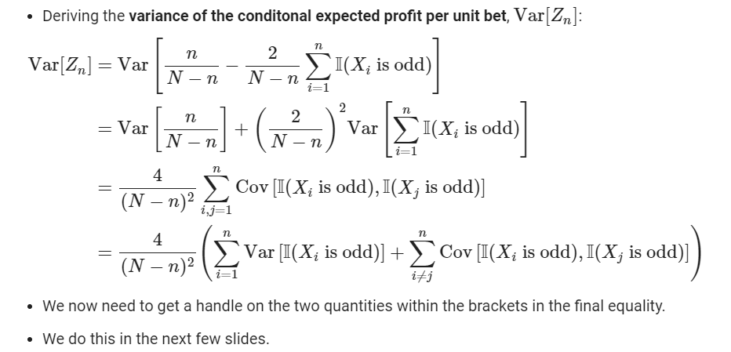
Red-black: Deriving the variance of the conditional expected profit per unit bet (2.)

Slide 57
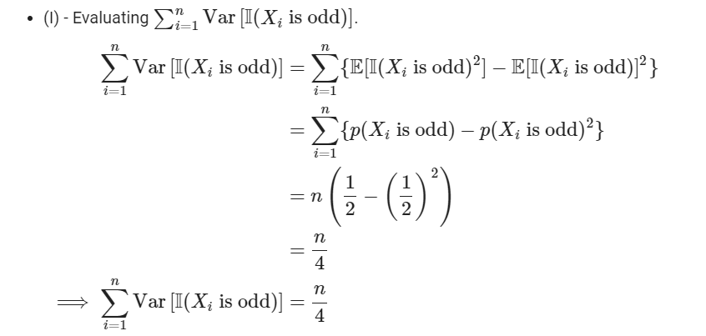
Red-black: Deriving the variance of the conditional expected profit per unit bet (2.)

Slide 58
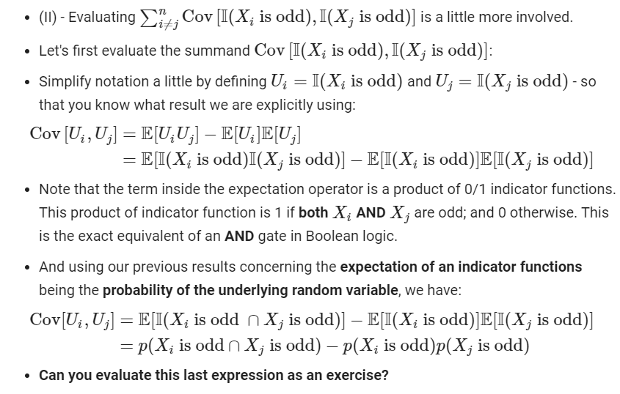
Red-black: Deriving the variance of the conditional expected profit per unit bet (2.)

Slide 59
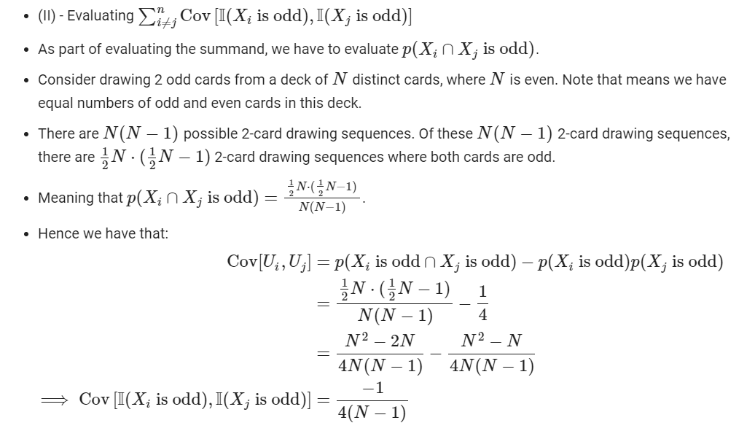
Red-black: Deriving the variance of the conditional expected profit per unit bet (2.)

Slide 60
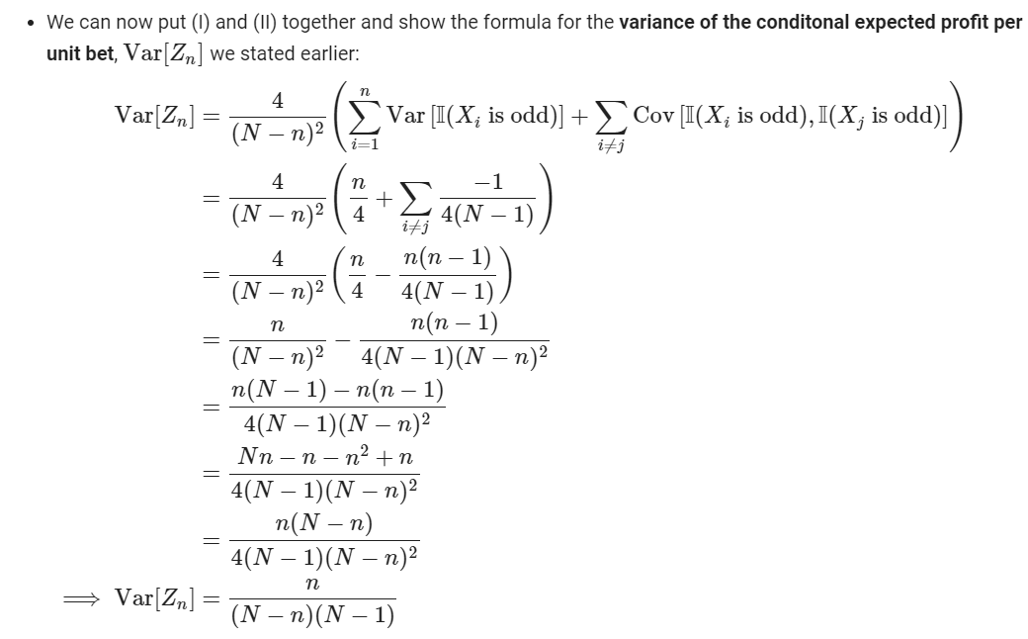
Red-black: Deriving the variance of the conditional expected profit per unit bet (2.)

Slide 61
Properties of the variance of the conditional expected profit per unit bet (2.)
If you were keeping on your toes, you may notice that we have not explicitly shown that the variance of the conditional expected profit per unit bet:
Lies in the interval [0,1) for n = 0,…,52.
Is increasing as the number of cards seen, n, increases.
We will get a feel for this using some numerical methods, but for now:
Can you use the tools you already have at your disposal to show this explicitly in an algebraic form?

Slide 62
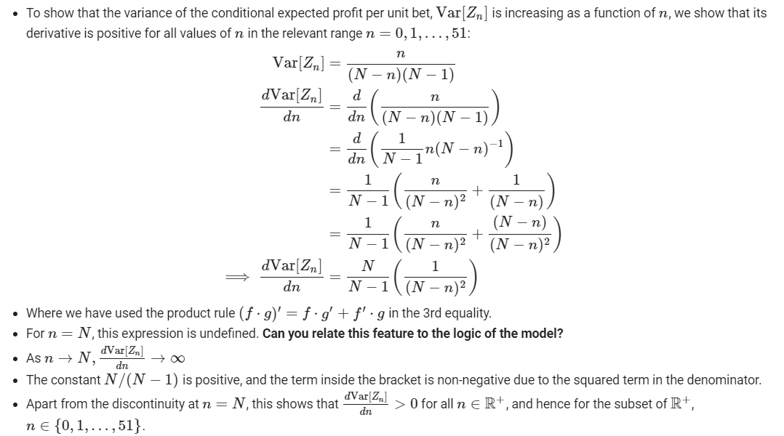
Properties of the variance of the conditional expected profit per unit bet (2.)

Slide 63
Red-black: Developing intuition for the algebra.
To develop some visual and numerical intuitions for what is going on:
Plot the probability mass function of the profit per unit bet.
Compute realisations of sequence of conditional expected profit per unit bet r.v.s. for N = 4 using pen and paper.
This to get a numerical feel for the conditional expected profit per unit bet r.v. based on a sequence of observed card labels; and how this can be used to inform betting behaviour.
Now go through the Colab Notebook “Red-black statistical analysis” for the case N=52.
Plot the variance of the conditional expected profit per unit bet as a function of n, using a symbolic computing package.
The primary results of interest you need to bear in mind are the mean and variance of the conditional expected profit per unit bet.
Because these are the tools which are used to state the fundamental theorem of card counting.

Slide 64
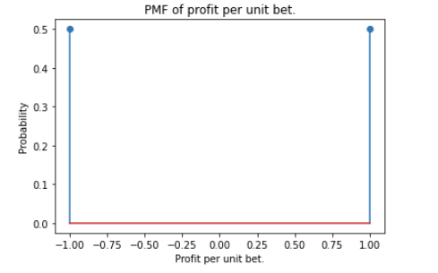

Slide 65
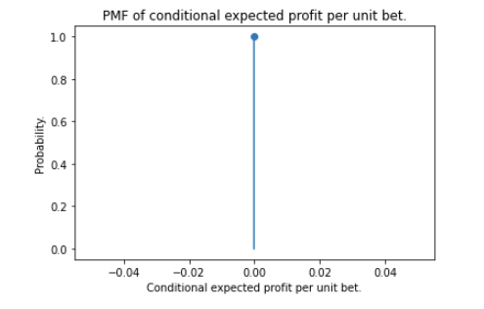
Probability mass function of the conditional expected profit per unit bet.

Slide 66
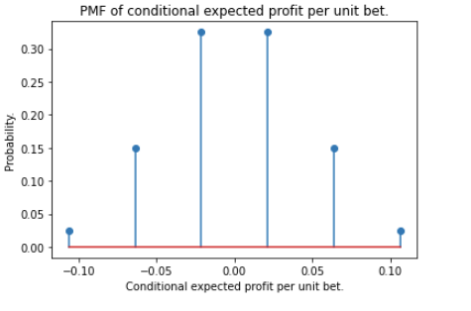
Probability mass function of the conditional expected profit per unit bet.

Slide 67
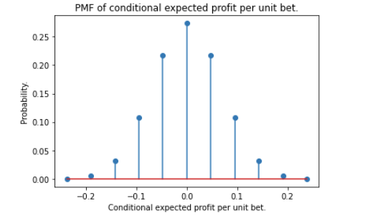
Probability mass function of the conditional expected profit per unit bet.

Slide 68
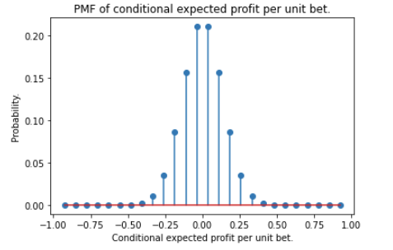
Probability mass function of the conditional expected profit per unit bet.

Slide 69
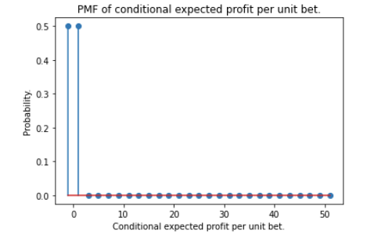
Probability mass function of the conditional expected profit per unit bet.

Slide 70
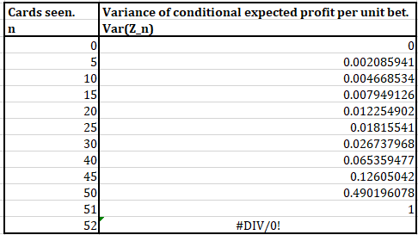
Variance of the conditional expected profit per unit bet, as function of cards seen, n; for deck size N = 52 cards.

Slide 71
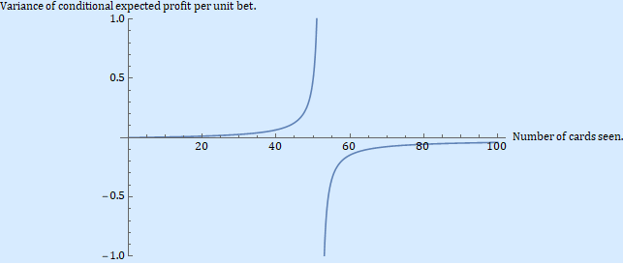
Plot of variance of the conditional expected profit per unit bet, as function of cards seen, n; for deck size N = 52 cards.
Note that this figure and the next only make sense for discrete values of cards seen, so it should really be a step function. Laziness at interfacing with Mathematica wins out this time…
Notes:
Look out for the

Slide 72
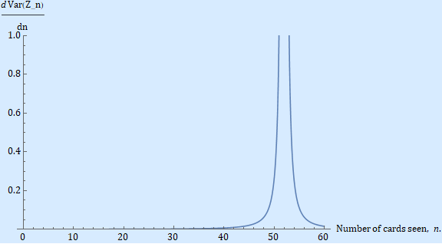
Plot of the derivative of the variance of the conditional expected profit per unit bet as function of number of cards seen, n; deck-size N=52.

Slide 73
Red-black: Cumulative distribution of the conditional expected profit per unit bet (3).
Now we’ve covered the main 2 results, there is one more result we need to look at.
Imagine we want to know how frequently in this toy game it is the case that our conditional expected profit per unit bet exceeds 0* i.e. there are profit opportunities to be exploited by raising our bets.
That’s equivalent to asking “what is the probability that our conditional expected profit per unit bet is greater than 0*”.
We can compute this probability in two ways:
a. Exactly, using the hypergeometric distribution.
b.Using a version of the Central Limit Theorem in a non-IID setting (that is in a situation of dependent trials, sampling without replacement) applied to random variables with a hypergeometric distribution.
In order to do this, we will need to introduce some new concepts, but they are not particularly intimidating, and they build on your knowledge of the binomial distribution and the Central Limit Theorem.
* Or some positive threshold.

Slide 74
Probability distributions.
You will most likely have encountered the binomial and normal probability distributions in your studies (and may be the Poisson).
There are many more distributions which have been derived to model various kinds of situations, across multiple disciplines:
Here are some examples, by application, from wikipedia:
Poisson distribution: Number of events in a fixed interval.
Exponential distribution: Time taken until an event occurs in a fixed interval.
Pareto distribution: Distribution of wealth in society, sizes of human settlements, values of oil reserves in oil fields.
Boltzmann distribution: Probabilities of discrete energy levels of a system in thermal equilibrium.
Survival function: Probability that a patient, device or other object of interest will survive beyond any specified time.
Zipf’s law/power-law distribution: frequency of words in the English language.

Slide 75
Hypergeometric distribution: sampling without replacement.
A useful distribution for computing probabilities in cards games is the hypergeometric distribution.
It is an adaptation of the binomial distribution to situations where we have sampling without replacement, and dependent trials.
It is a discrete probability distribution.
In abstract, the hypergeometric distribution allows us to compute the probability of k successes (random draws for which the object drawn has a specified feature) in n draws, without replacement, from a finite population of size N that contains exactly K objects with that feature, wherein each draw is a mutually exclusive success or failure.
As this is a little abstract, a good mental model to assist thinking about this distribution is to consider drawing green marbles from an urn containing red and green marbles.
We define our random variable, X, as the number of green marbles drawn from the urn, and we model this random variable with a hypergeometric distribution; that is, X ~ Hypergeometric (N, K, n)
The parameters of our distribution are as follows: N – total number of marbles in urn; K – no. of green marbles; n – no. of draws from the urn.
The hypergeometric distribution gives us a convenient way of computing P(X = k).

Slide 76
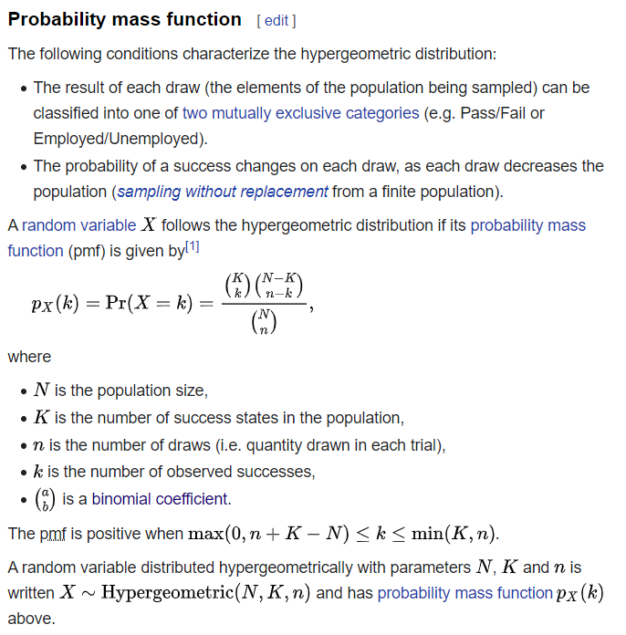
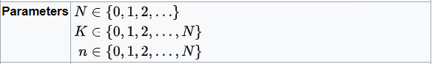
Hypergeometric distribution: probability mass function (PMF)
Can you get surgically pinpoint what precise aspect of the binomial distribution it is that renders it incapable by design of modelling situations of dependent trials/sampling without replacement?
Are there any similarities between the mean of the binomial and of the hypergeometric distribution?
In context of the red-black toy model, how might we use this distribution to assist?
Are you able to contextualise the distribution parameters for our problem?

Slide 77
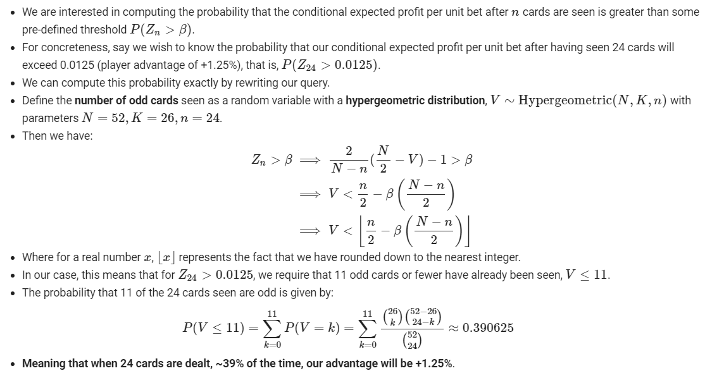
Red-black: Cumulative distribution of the conditional expected profit per unit bet (3a.)

Slide 78
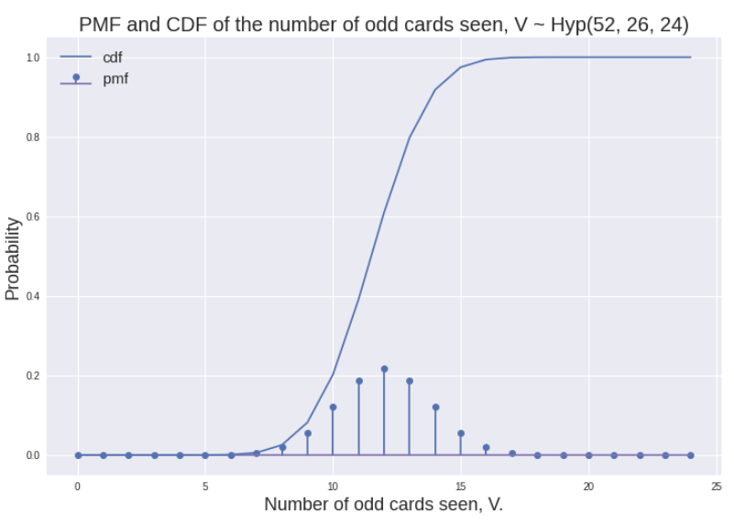
Hypergeometric PMF and CDF for number of odd cards seen.

Slide 79
Red-black: Cumulative distribution of the conditional expected profit per unit bet (3b.)

Slide 80
Further observations (optional) (4).
This section is optional, but highly recommended as a preliminary arena to develop intuition and understanding for what is going in the proof of the FTCC, which is stated for a more general setting than Red-Black.
Look at the formulae and plots we have presented, and consider the following.
1. Consider the sequence of conditional e

Slide 81
PART IIA- Narrative survey of the developments leading to HI-LO card counting.

Slide 82
Roadmap.
PART I – Preliminaries.
PART II – Toy model (Red-black).
PART IIa – Narrative survey of the developments leading to HI-LO Card Counting.
High-level questions.
“The optimum strategy in Blackjack.” (1956).
“A favourable strategy for twenty-one.” (1961).
“Beat the Dealer.” (1962).
Computation and interpretation of statistical evidence regarding representative subsets of the deck.
“Optimum gambling systems for favourable games.” (1969).
“The fundamental theorem of card Counting with applications to Trente-et-quarante and Baccarat.” (1973).
“On the fundamental theorem of card counting, with application to the game of Trente-et-quarante.” Ethier, S., Levin, D. (2005)
Key insights.
PART III - Fundamental Theorem of Card Counting (FTCC).
Red-black toy model key results.
Generalised fixed strategy model - setup, profit per unit bet, conditional expected profit per unit bet.
Statement of FTCC - fixed strategy.
Profit opportunities and discussion of FTCC.
Issues – intractability.
Connections with developments in information theory and communications engineering.
Proof of FTCC (fixed strategy).
PART IV – HI-LO Card Counting.

Slide 83
Continuing threads from earlier.
We just did a lot of mathematics, which we will return to in the next section.
For now I want to orient your analysis and critical questioning in a particular direction, and to use this interlude to look at some historical developments.
First a little bit about the nature of the mathematical and scientific method.
Often, when dealing with problems which seem intractable, or seem intractably complex, in this case, Blackjack, many solutions begin with a series of empirical or heuristic observations (make a distinction).
Depending on whether these are genuinely empirical observations, or more vague, qualitative, heuristic observations, scientists and mathematicians often from hypotheses or theories, and start validating or proving results.
Research these days is often a series of incremental results, that from the perspective of a career scientist or mathematician, may or may not lead to a breakthrough.
In this section, PART IIA, we will go through and look at the original research papers together.

Slide 84
High-level questions to think about.
Implicit in being willing to wager one’s cash (setting aside issues of detection, evasion, counter-evasion measures etc.) using the HI-LO system are two crucial questions:
1) Do there exist systematic profit opportunities that can be exploited using this system/are there systematic ways of reversing the House Edge?
If so, how can we detect these opportunities?
If so, what is the nature and strength of the evidence supporting the existence of these opportunities?
In order of strength: heuristic argument, simulation evidence, empirical observations, mathematical proof,
2) How should the system be designed in a manner so as to be:
Implementable in a casino without the use of computers.
Implementable with a tolerable margin of error, that is, with regard to a reasonable baseline of human cognitive abilities.

Slide 85
Building on the work of Baldwin, Maisel, Cantey, McDermott (1956).
Open the paper and go through highlighted areas.
Can go through derivations if required, but other than the general ingenuity of analysing the problem in the way the authors did, it is not a particularly palatable series of calculations (can attest with 1st hand experience).
It is generally acknowledged that this was the first systematic attempt at deriving an optimal strategy* for game of Blackjack with a 52 card deck.
*By optimal, we mean given that we do not use statistical information about previous cards that have been dealt.
Lots of people in gambling books at the time claimed they had the optimal strategy, but likely selling snake oil prior to the Baldwin et al. paper.
In context of the websites we visited – some things don’t change.

Slide 86
Key assumptions and simplifications in Baldwin, Maisel, Cantey, McDermott (1956).
Assumptions:
Equiprobability – the probability of drawing any card in the deck is 1/52.
Sampling with replacement – no matter how many cards the player draws, the probability of receiving any particular card on the next draw is still 1/52.
Those are formal, mathematical ways of describing the simplification. In the Blackjack community, it is commonly referred to as an “infinite-deck” assumption.
Approximations:
Probability of the dealer getting a final total of 17 or more.
Approximations due to the fact that they used a primitive computing device.
On equiprobability and sampling with replacement assumptions – what are your thoughts?

Slide 87
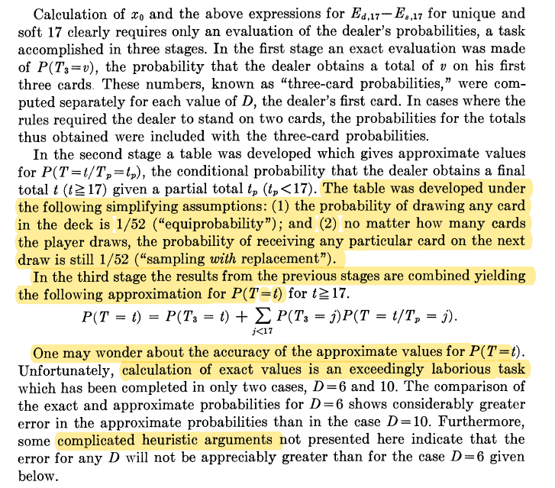
Baldwin, Maisel, Cantey, McDermott (1956).

Slide 88
Essence of Basic Strategy.
The Basic Strategy table is a decision rule telling you what action to take {H, S, Sp, D} based on the dealer’s upcard and the two cards you have been dealt.
This decision rule evaluates the
Clarify basic strategy expectations

Slide 89
Expectations under Basic Strategy.
Numbers.
Conditions when it holds.
Fluctuations.
Table of reported expectations for concreteness.
CE or UCE?
Remember to amend slide 89 once this is completed.

Slide 90
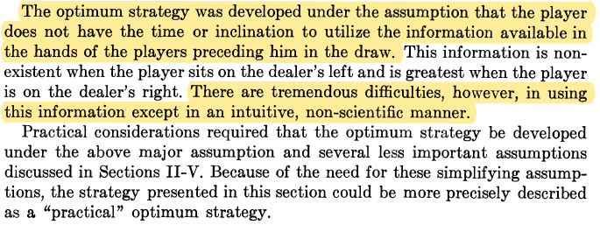
Building on the work of Baldwin, Maisel, Cantey, McDermott (1956).

Slide 91
Edward Thorp.
Edward Thorp is a UCLA statistics professor who read the 1956 paper by Baldwin et al.
He was also influenced by a paper written by John Larry Kelly Jr. called “A New Interpretation of Information Rate.” (1956) – more on this later.
Essentially, Thorp’s idea was to treat the highlighted sections in the previous paper as a challenge – to question whether one could do better.
Bearing in mind what we have seen with the toy model of red-black, do you think that using statistical information about previous cards that have been dealt will confer any advantages?

Slide 92
Brief note on the standards of rigour and “truth” amongst different forms of media.
A brief word on the distinction between a published book and a published paper.
Generally, published books, unless they are published as textbooks, or by academic publishers, tend to be written to a less rigorous standard of “truth” than published journal papers.
Journal papers go through what is known as a peer-review process. That is, the paper is vetted by a number of selected referees (often full-time professors at top universities).
Generally, these papers, as they are written for technical audiences, are uncompromising on rigour, and can feel difficult to read if you are not familiar with the discipline of the paper you are working in.
To get a feel for what I am trying to say – spend half an hour going through one of the papers in the shared Drive in your own time.

Slide 93
Very brief literature survey.
We will now outline Edward Thorp’s work to provide a brief narrative to understanding the developments that lead to the HI-LO card counting method.
We will take a scatter-gun, fragmented approach; and then bind together the key developments in an organised fashion later.
Edward Thorp publishes the journal paper “A Favourable Strategy for Twenty-One” (1961), containing some important empirical observations.
Edward Thorp published the “Five Count” and “Ten Count” strategy in “Beat the Dealer” (1962).
The HI-LO card counting system was presented by engineer/mathematician Harvey Dubner in 1963 at the Fall Joint computer conference under the presentation “Using computers in games of chance and skill.”*
Edward Thorp republishes “Beat the Dealer” with Dubner’s HI-LO system and a study of it under the “Complete Point Count” system (1966).
Sourcing the Dubner presentation is difficult – not sure if it’s in print.
*Note the title of this presentation.

Slide 94
“A Favourable Strategy for Twenty-One”, Thorp E. (1961).
Open the paper.
Baldwin et al.’s work to derive a proto-Basic Strategy used an approximation in computing the probability of a dealer getting a final total of 17 or more.
The key developments in Thorp’s 1961 paper were the following:
1. Use of a “high-speed computer program” to find a more accurate version of the player’s “best possible strategy” (read Basic Strategy) and “expectation” that avoided the use of the above approximation.
Consequence: More accurate player expectations calculations under Basic Strategy.
2. Adapting programming to run simulations/calculations for arbitrary sets of cards, that is taking into account cards that become visible during play.
Consequence 1: A step towards relaxing the simplifying assumption made in Baldwin et al.; and Basic Strategy calculations – equiprobability and sampling with replacement.
Consequence 2: A step towards accumulating statistical/empirical evidence that is in principle, reproducible.

Slide 95
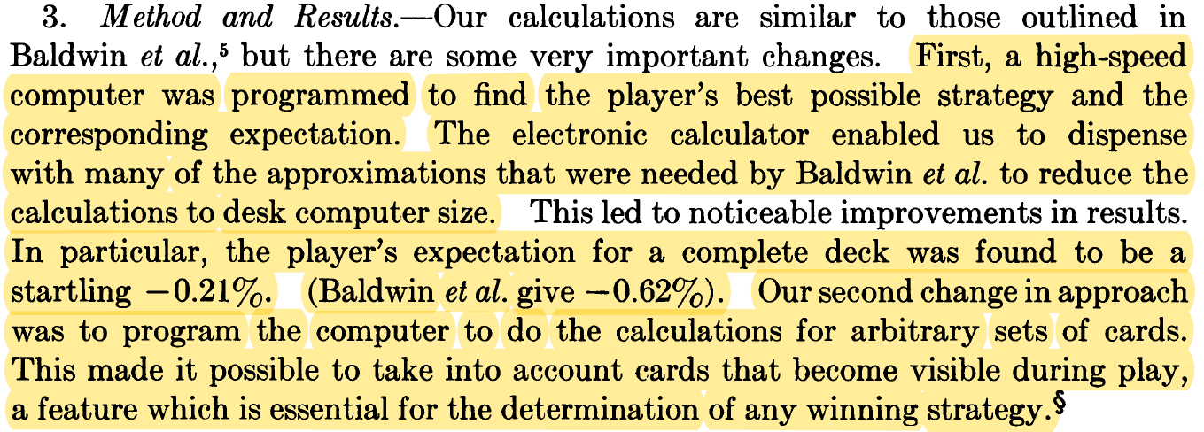
“A Favourable Strategy for Twenty-One”, Thorp E. (1961).

Slide 96
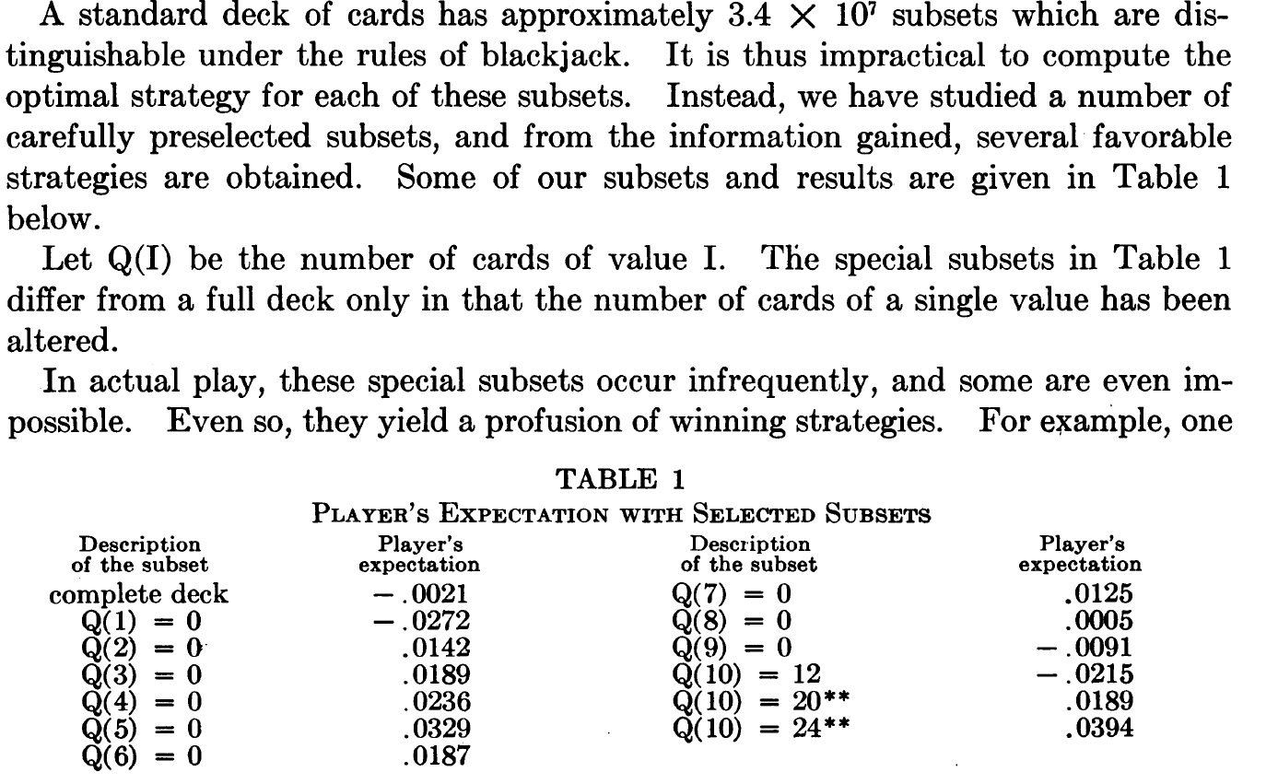
Table 1. - “A Favourable Strategy for Twenty-One”, Thorp E. (1961)

Slide 97
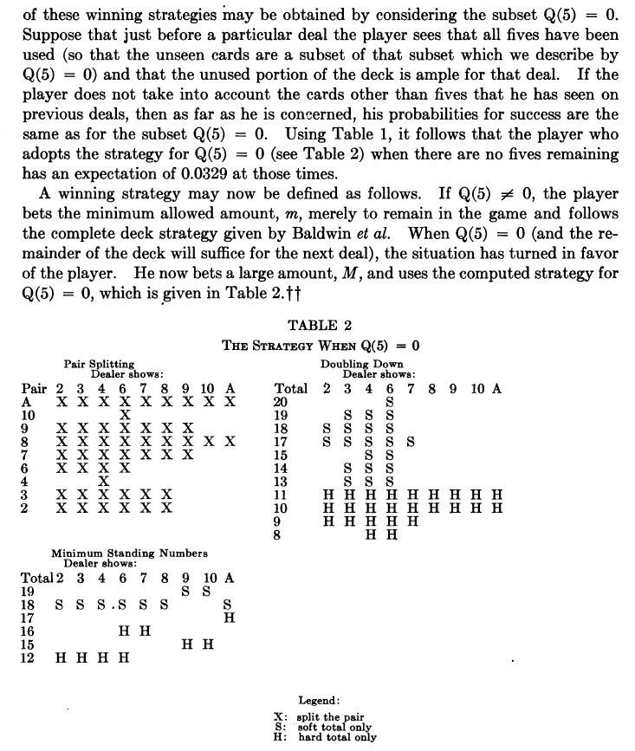
Table 1. - “A Favourable Strategy for Twenty-One”, Thorp E. (1961)
Focus on trying to get a sense for understanding how the previous table was computed.

Slide 98
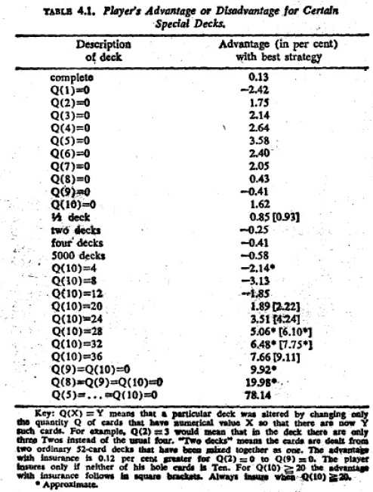
Table 4.1 - “Beat the Dealer”, Thorp, E. (1962).
Teaser questions:-
1. What does Q(X) = Y mean?
2. Why are some of the reported numbers in the 1961 paper and the 1962 book different?
We now need to get a handle on the following:
1. How were the numbers computed?*
2. Interpreting the statistical evidence presented.
* Why is this important?

Slide 99
Why should we be concerned with reproducing calculations, or reproducibility in science in general?
As an open-minded sceptic with elementary technical proficiency, we want to know how Table 1 and Table 4.1 were computed.
To the extent that, in principle, we could reproduce the calculations ourselves.
Reproducibility is a cornerstone of the scientific method – if results are not reproducible, do they still have value?
We will not fully reproduce the calculation – justify why.

Slide 100
1. Computation of the player advantage (expectations) for representative subsets of the deck.
Q(X) = Y means a subset of the complete deck where the numbers of card “X” remaining in the deck is Y.
E.g. Q(5) = 0 means a subset of the complete deck where there are no 5s remaining. Use this example for concreteness.
The player advantage percentages are computed in the following way:
1. Recompute Basic Strategy tables assuming that 4 “5s” from the 52 card deck have been removed, which we refer to from hereon as the “Q(5) = 0 specific Basic Strategy”.
2. This results in some minor variations to player drawing decisions to the Basic Strategy (see p49 of “Beat the Dealer”).
3. Recompute overall player expectations making use of Q(5)=0 specific Basic Strategy to get the entry in the table.
4. That means that when playing, once it is the case that Q(5) = 0, then the player’s expectation conditional on those 4 cards having been removed/only making use of the statistical information that those 4 cards have been removed is +0.0358 or 3.58%.
That suggests the rudiments of a partial strategy for winning, known as the “Five Count Strategy” in Thorp (1962):
A. When Q(5) ≠ 0, then bet the minimum amount/fishing bet and play the Basic Strategy (with a long run loss roughly equal to playing under 52-card Basic Strategy of XXX)
B. When Q(5) = 0, then bet a large bet and play the Q(5) = 0 specific Basic Strategy with a long win rate of +3.58%.
What is now a natural question to ask in light of the implementation of this strategy?

Slide 101
Frequency of favourable situations.
A natural question to ask is “how frequently will I be in a position where Q(5) = 0”, so that I can use the Five Count strategy?
See p55 of “Beat the Dealer,”, Thorp (1962) for details on how this is done for the Five Count strategy.
We will not delve any deeper into this, as it is appropriately covered when we cover the necessary formalisms in a more comprehensive and complete formulation of Blackjack using HI-LO card counting.
So for now, leave this as an open question to be answered later on.
We now want to focus on interpreting the statistical evidence that Thorp presented.

Slide 102
2. Interpreting the statistical evidence
Remembering how these numbers are calculated (i.e. cannot compare with HI-LO due to alteration of BS), comment on:
Q(1) = 0.
Effect of using more decks.
Q(2) to Q(9)
Q(10)
Q(9) = Q(10) = 0
Q(8) = Q(9) = Q(10) = 0

Slide 103
2. Interpreting the statistical evidence.
It might be tempting to try to align interpreting the evidence in such a way as to be consistent with the intuition encoded by the HI-LO card counting system.
The evidence is mixed.
The statistical evidence presented in previous slide assumes that we are playing a Q(X) = Y specific Basic Strategy.
Whereas the version of HI-LO card counting we consider does not involve altering Basic Strategy to be specific for a Q(X) = Y subset, but assumes we play a Basic Strategy.
So they are not entirely comparable calculations – we need to develop an alternative set of mathematical tools to cleanly rationalise the use of HI-LO card counting.
The statistical evidence in the previous slides were used by Edward Thorp to develop the “Five Count” and “Ten Count” system – profitable strategies in the days of 52 card decks, and during the cat-and-mouse between casino and player.
From perspective of developments in 1962, the beginnings of a more systematic empirical approach has coalesced, together with the idea of attempting to quantify the differential effects on player expectations of representative subsets of cards according to value.

Slide 104
A few remarks.
1936: Harvey Dubner goes onto develop HI-LO card counting.
We have seen some statistical evidence that might be used to justify the Five Count or Ten Count point system which Thorp developed.
But so far, none for HI-LO card counting. That will require more formal tools which we will develop later.
One of the most important contributions of this is that there might exist differential effects of certain card values on player expectations, meaning that we should study representative subsets.
This idea is important for the design of a counting system.
We now want to steer the literature survey to another related question:
Can we say any more about player expectations, conditioning on cards seen, as the deck progressively gets depleted; that is fully respecting Blackjack as a game involving dependent trials and sampling without replacement?

Slide 105
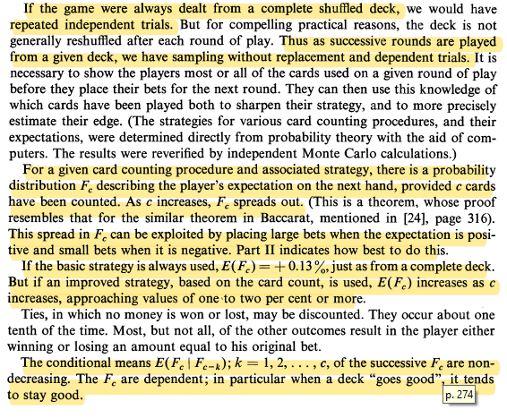
“Optimal gambling systems for favourable games.” Thorp, E. (1969).
Some really important mathematical claims being made here:
CLAIM 1.
CLAIM 2.
CLAIM 3.
CLAIM 4.
Any idea where the evidence for the claims has gone to?...
Turns out it wasn’t proved until 1973.

Slide 106
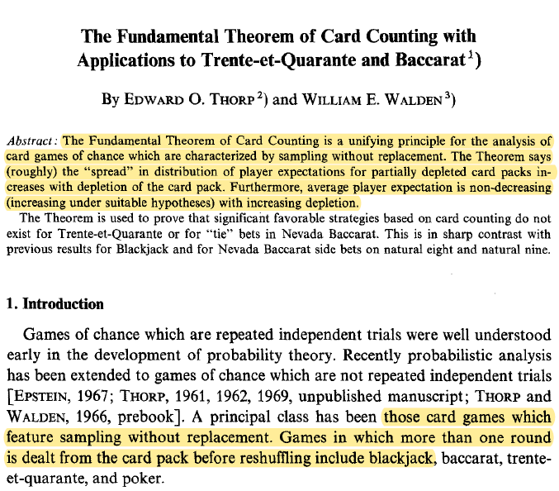
“The Fundamental Theorem of Card Counting with Applications to Trente-et-Quarante and Baccarat.” Thorp, E., Walden, W. (1973).
Previous 4 claims get subsumed into a result knowns as the “Fundamental Theorem of Card Counting.”
Even though the result can be stated easily in words, the proof uses some esoteric concepts in measure theory.
There is a proof of this result in a paper by Ethier, S. and Levin, D. (2002) which states and proves the result using more elementary tools.
We will go over this in Part III.

Slide 107
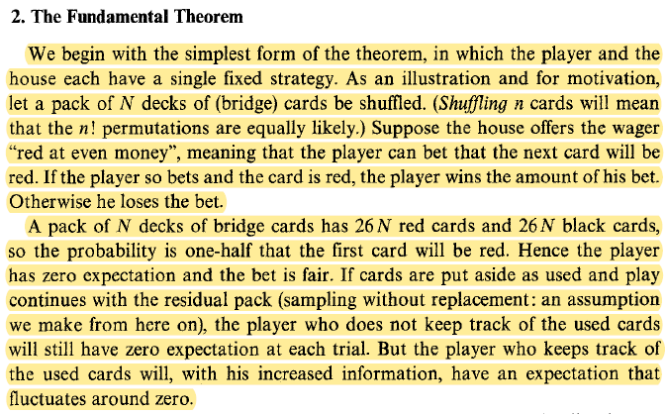
“The Fundamental Theorem of Card Counting with Applications to Trente-et-Quarante and Baccarat.” Thorp, E., Walden, W. (1973).
This is an exact description of the toy model we studied in Part II (differing in name only).
Can you reconcile the results stated in words here with the results we derived both algebraically, and examined using Colab in Part II?

Slide 108
“The Fundamental Theorem of Card Counting with Applications to Trente-et-Quarante and Baccarat.” Thorp, E., Walden, W. (1973).

Slide 109
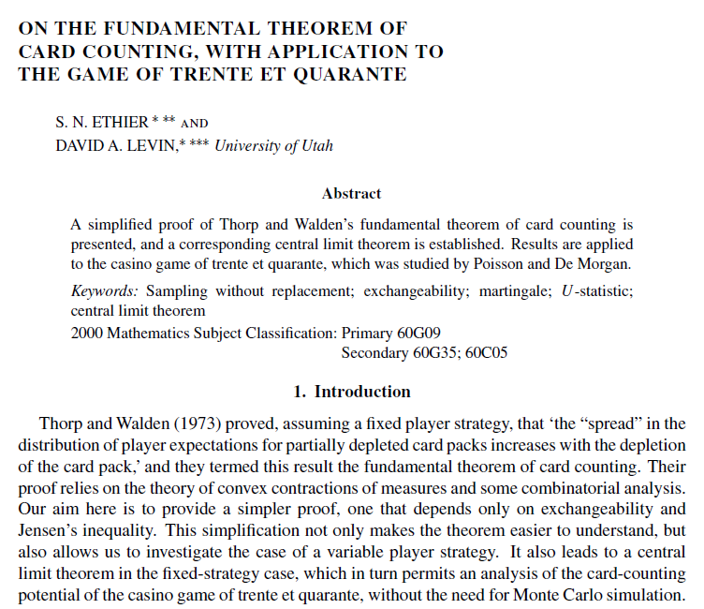
“On the fundamental theorem of card counting, with application to the game of trente-et-quarante.” Ethier, S., Levin, D. (2005)

Slide 110
Key insights to conclude the literature survey.

Slide 111
PART III – Fundamental Theorem of Card Counting (FTCC).

Slide 112
Overview.
Have the intuitions/results we developed in Part II in the toy model in the back of your mind.
We are going to generalise the formalisms we developed in Part II to state the claims of the Fundamental Theorem of Card Counting.
This section is mostly based on the paper by Stuart Ethier and David Levin (2002); and the textbook by the former, “The Doctrine of Chances.” (2010), with some added comments.
We may or may not prove this, depending on how ambitious you are feeling, so I will include these as supplementary slides.
I want to focus on how the appropriate use of mathematical formalism can go further to clarify the sometimes semantic fuzziness of describing these results in words.

Slide 113

Red-black toy model key results (review).

Slide 114
Generalised fixed strategy model: setup.
Consider the general situation of a game involving a deck of N cards, and that each coup/round requires up to m cards to be completed.
The deck is reshuffled if fewer than m cards remain.
Assume that the player plays a fixed strategy that does not vary depending on the cards that have been seen.
We represent our cards using indexed random variables as before.

Slide 115

Generalised fixed strategy model - profit per unit bet and conditional expected profit per unit bet.

Slide 116

FTCC: fixed strategy, Ethier, S. (2010)

Slide 117
FTCC: The existence of profit opportunities.
This is a proven theorem so that these results will hold true for all conceivable card games involving sampling without replacement and dependent trials that are appropriately described by the general fixed strategy model.
1) The mean of the conditional expected profit per unit bet is constant as the deck becomes more depleted.
2) The variance of the conditional expected profit per unit bet increases (monotonically) as the deck becomes more depleted.
This implies that there may exist profit opportunities under certain conditions*.
In a Blackjack context, the conditional expected profit per unit bet will fluctuate from coup to coup about the mean.
It indicates advantage to the House when it is negative and advantage to the player when it is positive.
As the deck becomes progressively more depleted, these fluctuations become greater.
Refer to the PMF plots of the conditional expected profit per unit bet for red-black as an example if you are having trouble developing a mental model of what this looks like visually.
An example of a strategy that could, in principle*, be used to systematically exploit the profit opportunities predicted by FTCC:
1. When the conditional expected profit per unit bet is positive, raise bets.
2. When the conditional expected profit per unit bet is negative, either refrain from betting, or make a fishing bet.
This was possible for red-black, but what obstacles are there preventing us from using this in practice for more complex card games?

Slide 118
FTCC: Discussion.
There remains a number of core issues that remain a barrier to implementing the previous suggested strategy.
We were able to devise a strategy to systematically profit in red-black due to the simplicity of the calculations.
The key simplicities:
1. Conditional expected profit per unit bet could be computed exactly.
We derived an exact, analytic expression for the conditional expected profit per unit bet, allowing us to calculate whether this was positive or negative.
2. A simple {+1,-1} point count system could be used, and under this system, the true count was exactly equal to the conditional profit per unit bet.
This was shown by rearranging the conditional expected profit per unit bet formula.
This means that the point count system could be used in place of computing the conditional expected profit per unit bet.
In practice, the point count system introduced a more practicable system with respect to the computational burden required, with no loss of “information”.
As it’s easier to compute the true count than the proportion of unseen cards in the deck.
This ease did not come with a cost in terms of binning potentially useful information about the conditional expected profit per unit bet.
Revisit the expressions and assess this final point on practicability in red-black for yourself.
In light of the tractable and practicably implementable calculations, it is difficult to appreciate the results that the FTCC provides in red-black.

Slide 119
FTCC: Some of the issues Blackjack raises.
For Blackjack:
1. Exact computation of conditional expected profit per unit bet is not possible for realistic settings likely to be encountered in a casino (e.g. using 6 decks), even with the aid of the computers.
Due to primarily combinatorial complexity of the game, and due to the current state of commercially available hardware/computing power, algorithms, and time constraints.
2. Related quantities of interest, such as the mean and variance, or CDFs of the conditional expected profit per unit bet therefore also cannot be computed exactly*.
Ethier and Lee (2019): These “quantities would require 3.7 trillion evaluations of the basic strategy expectation (which itself is too complicated to be expressed as a rational function) and would be computationally prohibitive.
An implication of FTCC is due to the (monotonically) increasing variance of the conditional expected profit per unit bet, profit opportunities may arise and these occur when the conditional expected profit per unit bet is positive.
However, if we cannot even compute the conditional expected profit per unit bet with the aid of computers:-
How can we expect to identify profit opportunities, i.e. coups where the conditional expected profit per unit bet is positive, in a real-life casino setting in a way which can implemented by a player with average cognitive abilities?
Take some time to appreciate that in spite of this difficulty, remarkably, human ingenuity still managed to devise a practicable strategy that could be implemented in a casino without computers.
*Would be nice to quantify the combinatorial, algorithmic and computational complexity a little more precisely – future endeavour.

Slide 120
Quick question: Faced with the previous difficulties raised, do you have any ideas on how we might proceed?

Slide 121

Analytic and computational intractability – the orientation of modern applied mathematics, statistics.
Much of modern, real-world applied mathematics and statistics is messy – there many instances in which we cannot derive analytic solutions for problems we have setup, but have to rely on approximations, or numerical methods.
Here are some examples:
Integral of $\frac{\sin{x}}{x}.$
3-body problem in classical mechanics.
Black-Scholes partial differential equation for European options pricing.
Variational approximations to the exact wavefunction and energy in quantum mechanics.
Mean-field approximations for evaluating partition functions in Ising models.
Monte Carlo methods for modelling neutron diffusion in a medium (Manhattan Project).
Monte Carlo methods for approximating intractable posterior normalisation constants in Bayesian statistics.
Training a neural networks for object recognition/optimising loss functions.
Stochastic optimisation algorithms for working with massive datasets.

Slide 122
Connections with information theory and communications engineering.

Slide 123
Part IIIb – Proof of the Fundamental Theorem of Card Counting (FTCC).

Slide 124
Proof of the FTCC (fixed strategy).
The proof in Ethier and Levin (2005) and Ethier (2010), is written in the spirit of mathematicians, that is, concise; which can be terse if you are unfamiliar with some of the concepts.
These are written for a target audience whom the authors assume have fluency with these unfamiliar concepts (i.e. mathematicians); or assuming that you have acquainted yourself with earlier pre-requisite chapters in the book.
In this section, we will walk through this proof at a level that assumes less familiarity with the concepts being used (college/high-school level), and so we are more explicit in the steps used in the chain of reasoning.
But first we need to develop some more tools.
This would not be possible to do in one presentation,

Slide 125

Proof of FTCC, Ethier, S. (2010).
Notice that the proof is quite concise.
However, we will need to develop the appropriate tools and results to understand the reasoning being used.
We will do so with a view to conveying what is necessary for intuitive understanding, without getting tied up in excessive rigour.

Slide 126
We need to develop the following tools and results. We do so for discrete random variables.
Conditional expectations using random vectors, useful properties.
Convex functions.
Jensen’s inequality (classical, probabilistic, conditional forms).
Exchangeable random variables.
Martingales (specifically, Doob’s martingale).

Slide 127

Convex functions.

Slide 128

Convex functions.

Slide 129

Jensen’s inequality.

Slide 130

Jensen’s inequality.

Slide 131
Jensen’s inequality.

Slide 132
Exchangeability.

Slide 134
“Martingale betting systems”
We will now cover the primary concept that underpins the FTCC, that is, martingales.
The term “martingale” is used in a number of senses which need to be clarified.
The informal meaning of a martingale is a martingale betting system, or in modern parlance, as a “progressive betting system”.
This system consists of doubling one’s bet when you lose, that is, continuing to double your bet until you finally win.
These systems are often touted by people as “inside-dope” on how to gain an edge in a casino. These people either do not understand maths, or gambling, or do not understand both. They do not work.
We will not waste time looking at why they do not work, rather we focus on an elementary mathematical definition of a martingale – a sequence of random variables (i.e. a stochastic process) with certain properties.
However, it is the gambling context of the informal meaning of the martingale that led to the development of the technical concept; which with the development of modern probability theory via measure theory, can be expressed in more abstract terms without recourse to the gambling context.

Slide 135

Martingales.

Slide 136

Martingales – properties.

Slide 137

Martingales – fair games.

Slide 138

Fair, subfair, superfair games.

Slide 139
Exercise.
The point of this exercise is to make use of the definitions above, to see how casinos collect commission/implement an edge; and to see how subfair and superfair games relate to supermartingales and submartingales, respectively.
Roulette: 37 numbers, 0-36. The numbers 1 – 36 contains 18 black numbers and 18 red numbers. 0 is green. Consider wagering £1 on red – the odds paid by the casino are 1:1 (even money). Meaning that if the ball lands on red, then you make a profit of £1. If the ball lands on black, or on 0, you make a loss of £1.
Compute the expectation of your profit, and determine whether the game is fair, superfair, or subfair.
Why is that the case? What modifications to the game have the casinos made to ensure that is the case?

Slide 140

Exercise.

Slide 141
Martingales – gambler’s ruin.

Slide 142
Doob’s martingale.

Slide 143
Convex functions of martingales.

Slide 144
Proof of the FTCC.

Slide 145
Supplementary proofs.
Jensen’s inequality for multiple points.
LIE for martingale.

Slide 146
Part IV: HI-LO card counting.

Slide 147
A heads-up.
The mathematics in this section is really going to ratchet up a bit, and there will be a lot of new concepts and new notation that will be covered.
Not all of this can be grasped in one sitting, and will almost certainly require you to review, question, and reconstruct the narrative/knowledge yourself in your own time.
It is common with presentations with a high density of new notation and concepts for students to get “lost” in the symbols, as they forget what something stands for, or don’t completely understand the logic of a move.
And it can be a challenge managing to hang on to the big-picture whilst dealing with the details.
The onus is on you to communicate that something is unclear, or you don’t understand, and I will be happy to have another go at explaining.
The general approach of this section is to develop the theoretical tools (i.e. various statistical approximation techniques) first, then to apply these tools to the HI-LO card counting case as an empirical exercise.

Slide 148

Roadmap.
The following tools will be developed:
1. Effects of removal (EoR).
2. Approximate conditional expected profit per unit bet, under a statistical hypothesis, ${\hat{Z}}_{n}$.
Crash course in ordinary least squares linear regression.
Justifying the statistical hypothesis via ordinary least squares (OLS) linear regression.
OLS estimators of parameters/single-card payoffs.
3. Approximate conditional expected profit per unit bet, under a generalised point-count system, $Z_{n}^{∗}$.
Ordinary least squares (OLS) linear regression of scaled effects of removal on point count.
4. Probability of approximations of the conditional expected profit per unit bet exceeding a threshold.
a. Central Limit Theorem for finite samples from a population.
b. Probability of player advantage under exceeding a threshold.
c. Probability of point count exceeding a threshold.
5. Expected approximate conditional expected profit of a card-counter exploiting superfair betting opportunities.

Slide 149
Roadmap (continued).
And those tools will be used quantitatively in the following order:
6. HI-LO card counting for bet variation.
a. Approximate conditional expected profit per unit bet using (scaled) effects of removal (EoRs).
b. Computing effects of removal (EoRs).
c. Approximate conditional expected proft per unit bet using HI-LO point counts.
d. Quantifying the statistical relationship between scaled effects of removal and HI-LO.
e. Asymptotic distribution of the approximate conditional expected profit per unit bet under HI-LO.
f. True count statistic for bet variation.
h. Computing player advantage probability under HI-LO, card- counter expected profit.
i. Key results.

Slide 150

1. Effects of removal

Slide 151

A little notation.

Slide 152

A statistical hypothesis.

Slide 153

Convenient expressions.

Slide 154

2. Approximate conditional expected profit per unit bet under statistical hypothesis (unseen cards).

Slide 155

2. Approximate conditional expected profit per unit bet under statistical hypothesis (seen cards).

Slide 156

2b. Justifying the statistical hypothesis.

Slide 157
Linear regression.
We will now examine how linear regression is used to justify approximation of the conditional expected profit per unit bet as an average of single-card payoffs.
Underlying the use of linear regression shows that:
1. The conditional expected profit on a set of unseen cards is assumed to be a linear function of the presence or absence of a particular card within that set of unseen cards.
2. The parameters of this statistical relationship represent the marginal effect of the inclusion of a particular card on the player’s conditional expectation.
3. Under appropriate assumptions, we can get ordinary least squares (OLS) estimates of these parameters.
4. These OLS estimates are chosen so as to minimise the sum of squared residuals
5. These OLS estimates are

Slide 158


Slide 159

2b. Statistical hypothesis: linear regression.

Slide 160

2c. Ordinary least squares (OLS) estimators of parameters/single-card payoffs.

Slide 161

2c. Normal equations.

Slide 162
2c. Combinatorics exercise.
This will come in useful for the next derivation.
Define the set S to contain digits from 1 to 5, that is, S = {1, 2, 3, 4, 5}.
How many ways are there of choosing 3 digits from set S without regard to ordering?
Equivalently, how many 3-digit subsets are there of set S?
How many 3-digit subsets are there of set S which contain a 1?
How many 3-digit subsets are there of set S which contain a 1 and a 2?
Generalising, define the set D to contain digits from 1 to 52, that is D = {1, 2, …, 52}.
How many m-digit subsets are there of set D which contain a 1?
How many m-digit subsets are there of set D which contain a 1 and a 2?

Slide 163


Slide 164
Pending email response on averaging.

Slide 165

2. Approximate conditional expected profit per unit bet, under a statistical hypothesis (scaled effects of removal).

Slide 166

Approximate conditional expected profit per unit bet, under a generalised, balanced, point-count system

Slide 167

Approximate conditional expected profit per unit bet, under a generalised, balanced, point-count system.

Slide 168

Regression of scaled effects of removal on balanced point counts – minimising sum of squared residuals.

Slide 169

OLS estimators of the regression coefficient of scaled effects of removal on balanced count.

Slide 170
Motivating the use of the central limit theorem for samples from a finite population.
We now have two approximations for the conditional expected profit per unit bet.
Let’s now introduce some terminology from the mathematics of gambling and statistics literature:
A superfair bet is a bet whose expected value is positive.
A subfair bet is a bet whose expected value is negative.
Thus an informed gambler is generally on the lookout for superfair bets.
A natural question we might ask is “how frequently is a superfair bet available in Blackjack after n cards have been seen?”
Formally, this is equivalent to asking “what is the probability that the player approximate conditional expected profit per unit bet is greater than 0?”
At the heart of answering this question lies a variant of the central limit theorem (CLT) that holds for samples from a finite population, i.e. weakly dependent random variables that are not independent and identically distributed.
In order to state this result and show how it’s used, we first need to refresh on the central limit theorem for independent and identically distributed random variables first, before moving to case where we have samples from a finite population.

Slide 171

Properties of the sample mean.

Slide 172

Central limit theorem for IID random variables.

Slide 173

Central limit theorem for IID random variables.

Slide 174
Q: Isn’t the central limit theorem a statement about how you can approximate the distribution of the sample mean (i.e. the sampling distribution) with a Normal distribution?

Slide 175

Continuous mapping theorem.

Slide 176

CLT for IID random variables.

Slide 177

CLT for IID random variables.

Slide 178

CLT for IID random variables.

Slide 179

CLT for IID random variables.

Slide 180

4. Probability of approximations of conditional expected profit per unit bet exceeding a threshold.

Slide 181

4a. Central limit theorem for samples from a finite population, Erdos P., Renyi, A. (1959).
A little bit of history and context.
This paper is a proof published in a journal (slightly obscure) for the mathematical community.
To the best of my knowledge, it was Peter Griffin, the author of “The Theory of Blackjack” who first cited this result and its applicability to Blackjack in a paper in published in an interdisciplinary studies journal in 1976 (see references at the end).
As the notation in this paper is a bit quaint, we use a contemporary version of this theorem stated by Ethier (2010).

Slide 182

4a. Central limit theorem for samples from a finite population, as stated in Ethier, S. (2010).
This more contemporary statement of the result by Erdos and Renyi (1959) will be suited for our purposes.
This result is used for get the 2 convergence in distributions results that were stated on slide 154.
We will now go through how this result is used and the derivations, using the tools we developed previously.

Slide 183
4a. Central limit theorem for samples from a finite population, as stated in Ethier, S. (2010).
The following questions will assist you

Slide 184

4b. Probability of player advantage under effects of removal exceeding a threshold.

Slide 185

4b. Probability of player advantage under effects of removal exceeding a threshold.

Slide 186

4b. Probability of player advantage under effects of removal exceeding a threshold.

Slide 187

4c. Probability of player advantage under a point-count exceeding a threshold.

Slide 188

4c. Probability of player advantage under a point-count exceeding a threshold.

Slide 189

4c. Probability of player advantage under a point-count exceeding a threshold.

Slide 190

4c. Probability of player advantage under a point-count exceeding a threshold.

Slide 191

5. Expected approximate conditional expected profit of a card-counter exploiting superfair betting opportunities.

Slide 192

Law of the unconscious statistician.

Slide 193

5. Expected approximate conditional expected profit of a card-counter exploiting superfair betting opportunities.

Slide 194

5. Expected approximate conditional expected profit of a card-counter exploiting superfair betting opportunities.

Slide 195

5. Expected approximate conditional expected profit of a card-counter exploiting superfair betting opportunities.

Slide 196

5. Expected approximate conditional expected profit of a card-counter exploiting superfair betting opportunities.

Slide 197

5. Expected approximate conditional expected profit of a card-counter exploiting superfair betting opportunities.

Slide 198

Symmetry of standard normal PDF.

Slide 199

Symmetry of standard normal PDF.

Slide 200

5. Expected approximate conditional expected profit of a card-counter exploiting superfair betting opportunities.

Slide 201

5. Expected approximate conditional expected profit of a card-counter exploiting superfair betting opportunities.

Slide 202
Caveats on the use of asymptotic results we have derived.

Slide 203
6. Application to HI-LO card counting for bet variation.
We now use all the theoretical results we’ve derived to get some empirical results.
We will do this in context of a single-deck game of Blackjack, where N = 52, and defer discussions of extension to the end.
In particular the empirical work will allow us to provisionally quantify/answer the following, assuming a controlled setting:
1. Can the application of HI-LO card-counting to vary bets render Blackjack a profitable game?
2. If so, how frequently do profit opportunities/superfair bets exist, and what is the magnitude of this opportunity?
What is the probability of the player’s advantage under a point count system exceeding a threshold as the deck is progressively depleted?
3. What is the average profit a card-counter using HI-LO card counting to vary their bets can expect to make?
What is the expected profit available per unit bet as the deck gets progressively more depleted, assuming a card counter implementing Basic Strategy and bet variation to exploit superfair bets.
4. Do the empirical results validate, falsify or prompt more investigation into the predictions of the Fundamental Theorem of Card Counting (which under appropriate conditions enjoy the status of deductive truth)?
This section is almost entirely based on Chapter 21 of the monograph by Ethier (2010).

Slide 204

Representing the contents of an ordered Blackjack deck.

Slide 205

6a. Approximation of the conditional expected profit per unit bet using effects of removal.

Slide 206

6b. Effects of removal (EoR).

Slide 207

6b. Computing effects of removal (EoR), from Ethier (2010).
Each of the effects of removal EoR(i) are computed* for the 10 distinct card values in Blackjack, and multiplied by 100.
Interpret the following:
EoR(i) for aces, tens.
EoR(i) for twos to sixes.
EoR(i) for sevens to nines.
What do you think the “correlation” line refers to?

Slide 208

(Im)practicability of using the approximate conditional expected profit per unit bet using EoRs.

Slide 209

6c. Approximation of the conditional expected profit per unit bet using the HI-LO point count system.

Slide 210

6d. Balanced point count systems for Blackjack and the HI-LO point count system.

Slide 211

Data prep: Computing scaled effects of removal for N = 52.
Using the effects of removal computed in column 2,Table 21.9 of Ethier (2010), we compute the scaled effects of removal by multiplying each entry in that column by 51/100 to yield column 3 and 6 in the table to the right.
Notice that whilst the order in which the 10 card denominations {A, 2,…,K} are revealed in a shuffled deck is random; due to the quantities of each card denomination in a standard deck, it is guaranteed that over the entire deck, we will draw an {A} 4 times, and hence E(1) and J(1) 4 times, … a {10} 16 times, and hence E(10) and J(10) 16 times etc.
Let’s now visualise what the regression coefficient we are trying to estimate.

Slide 212

Bivariate scatter plot between scaled EoR and HI-LO point count.

Slide 213

OLS estimator of regression coefficient.

Slide 214

Scaled EoR and HI-LO statistics.

Slide 215

Correlation coefficient between HI-LO point count and scaled EoR.

Slide 216

6e. Asymptotic distribution of approximate player advantage under HI-LO.

Slide 217

Asymptotic distributions of the approximate player advantage using HI-LO, as the deck is progressively depleted.

Slide 218

Asymptotic variance of player advantage under HI-LO card counting.

Slide 219

6f. True count adjustment factor.

Slide 220

Bet variation using the HI-LO true count.

Slide 221
Z_n – HI-LO diagram

Slide 222

6h. Estimating player advantage probability under HI-LO, card-counter expected profit.

Slide 223


Slide 224


Slide 225

6i. Key results.
The table answers the following questions:
1. Can the application of HI-LO card-counting to vary bets render Blackjack a profitable game?
2. If so, how frequently do profit opportunities/superfair bets exist, and what is the magnitude of this opportunity as the deck is progressively depleted?
3. What is the average profit a card-counter using HI-LO card counting to vary their bets can expect to make?

Slide 226

Visualising the key results.

Slide 227

Plot of the advantage probability under HI-LO and card-counter expected profit approximations as deck becomes progressively depleted.

Slide 228

Plot of the advantage probability under HI-LO and card-counter expected profit approximations as deck becomes progressively depleted.

Slide 229

Plot of the advantage probability under HI-LO and card-counter expected profit approximations as deck becomes progressively depleted.

Slide 230

Plot of the advantage probability under HI-LO and card-counter expected profit approximations as deck becomes progressively depleted.

Slide 231

Plot of the advantage probability under HI-LO and card-counter expected profit approximations as deck becomes progressively depleted.

Slide 232

Plot of the advantage probability under HI-LO and card-counter expected profit approximations as deck becomes progressively depleted.

Slide 233

Plot of the advantage probability under HI-LO and card-counter expected profit approximations as deck becomes progressively depleted.

Slide 234

Plot of the advantage probability under HI-LO and card-counter expected profit approximations as deck becomes progressively depleted.

Slide 235
Role of asymptotic variance.

Slide 236
Betting staircases, commission.

Slide 237
Use of approximation (linearisation)

Slide 238
Practicalities.

Slide 239
Casino counter-measures.

Slide 240
Player evasion methods.

Slide 241


Slide 242
* On this basis there remains the thorny question of **how appropriate is this approximation**, given that we cannot compute the exact conditional expected profit per unit bet? We will defer this line of questioning until later.

Slide 243
References.
Under construction.

